Slide 1
OUR EXPERIENCE IN SKOVLUND EFTERSKOLE

Slide 2
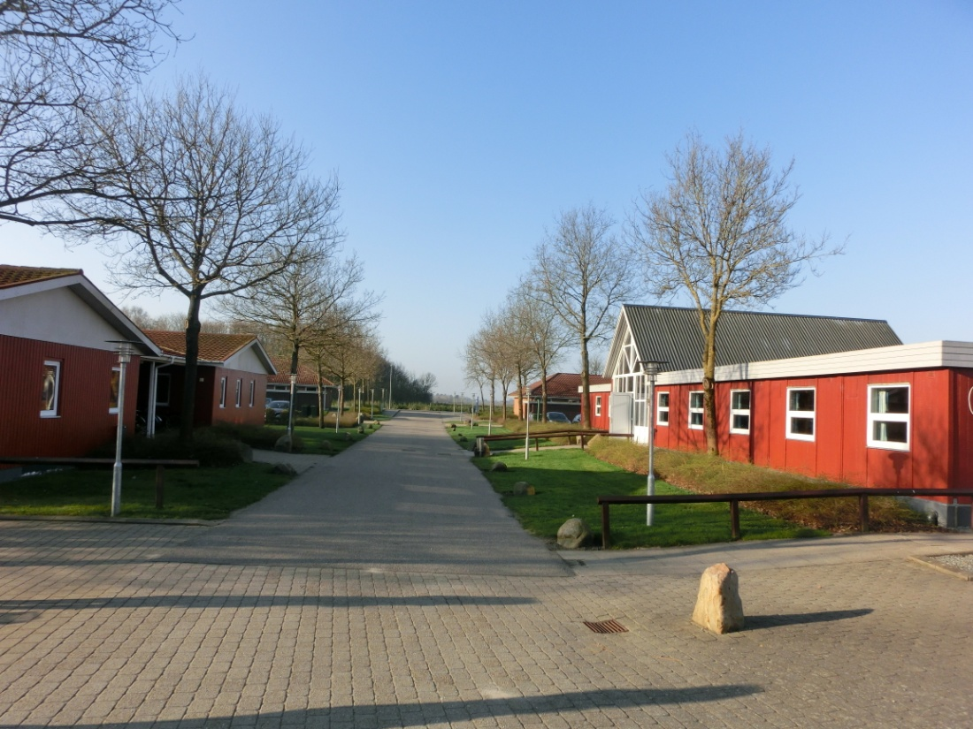
Skovlund Efterskole is a boarding school, which means that the students don’t only study there: infact during the week they live at school, sleeping, eating and doing activities all together.
They live in little houses and during their free time they relax and play in common rooms.

Slide 3
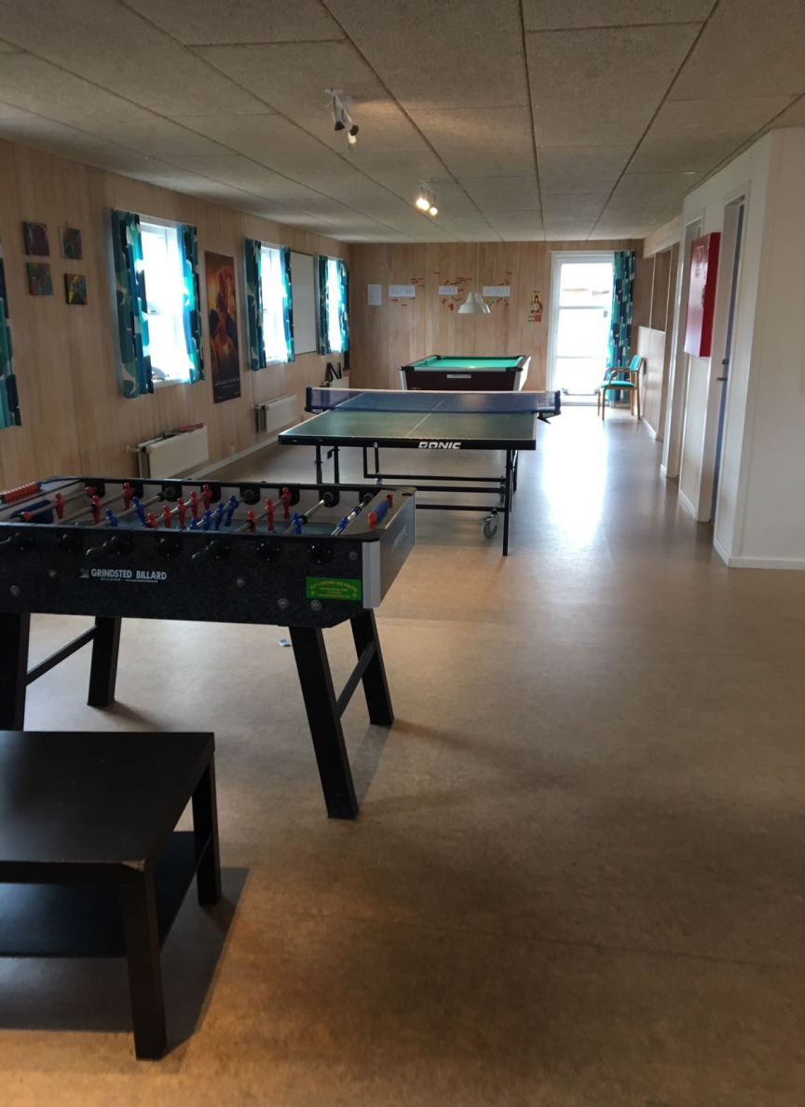
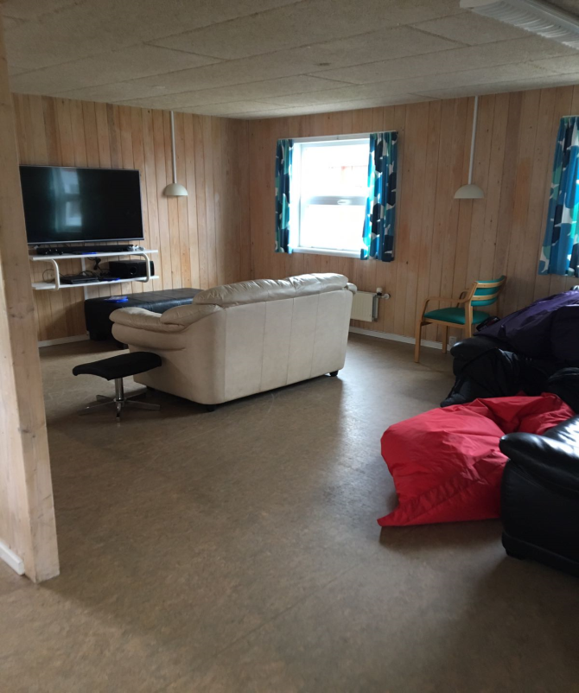

Slide 4
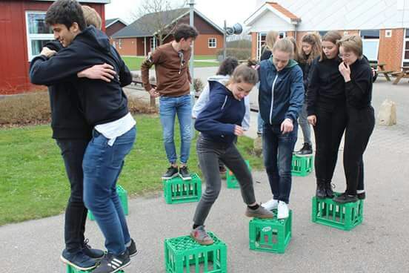
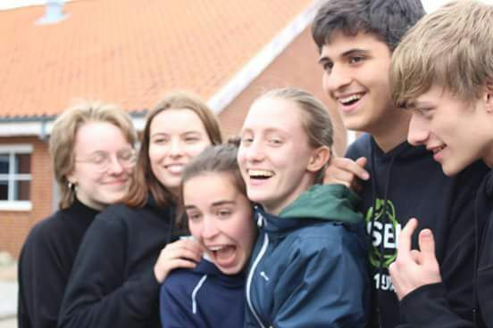
When we arrived the students showed us the school and we had fun doing some games to know each other better.

Slide 5
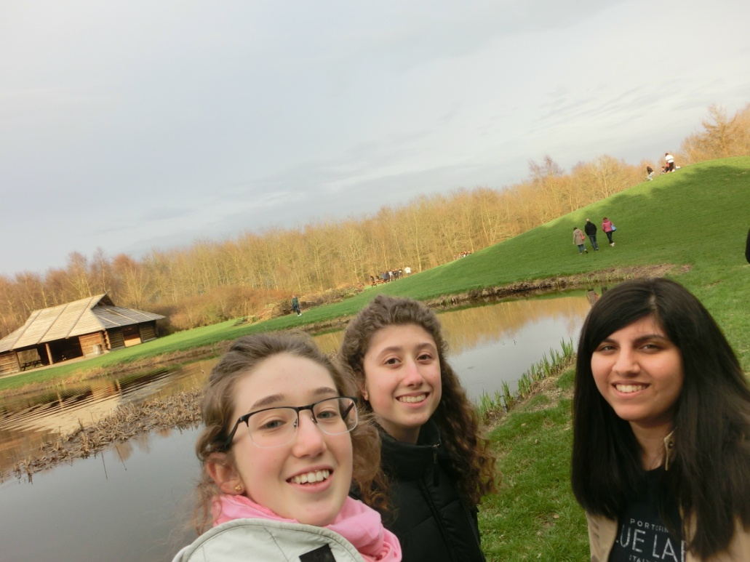
The evening we visited the park and we played volleyball and some new danish games.

Slide 6
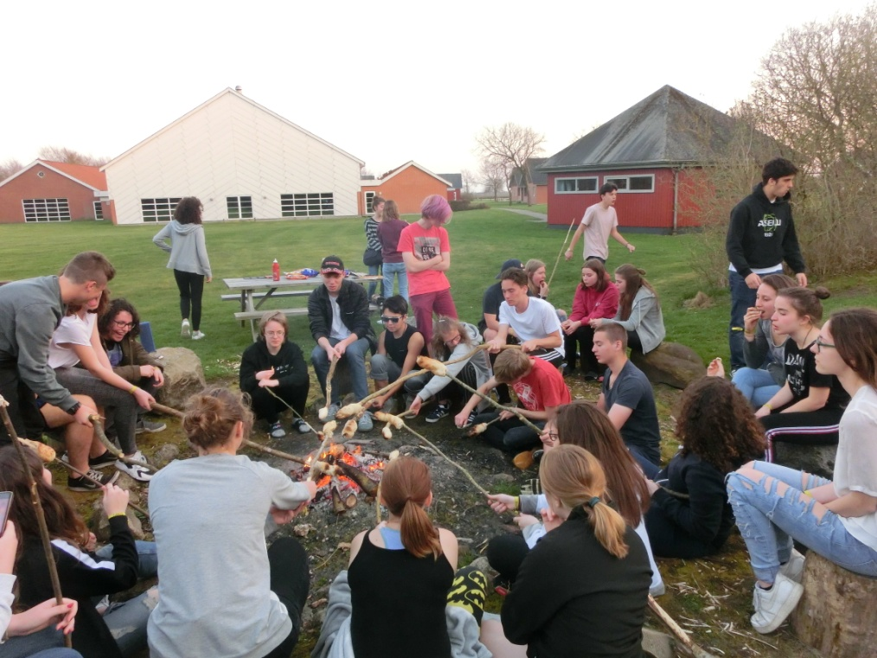
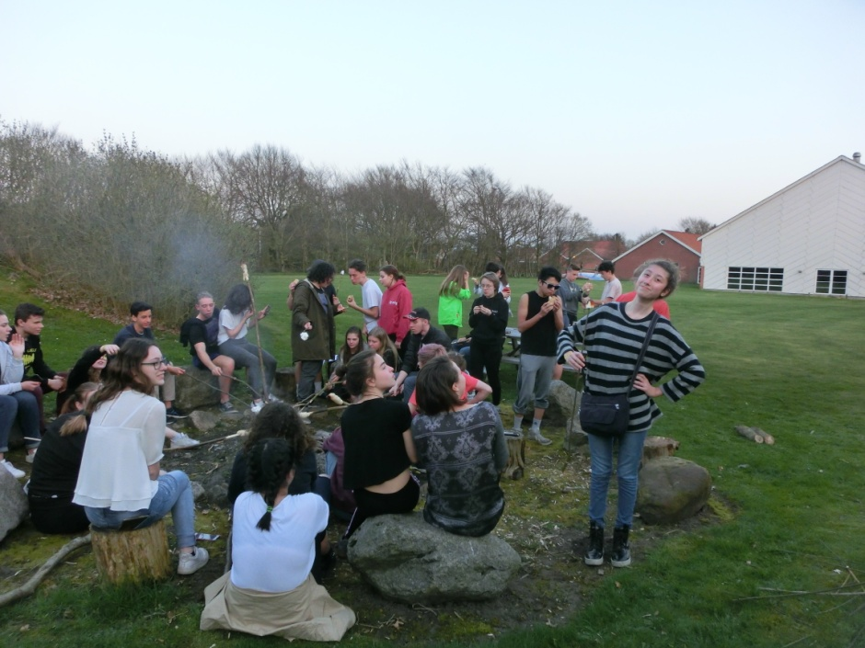
During the last evening in Skovlund we had a bonfire. We ate handmade bread and marshmallows cooked over the fire.
It was a really funny experience and the food was good.

Slide 7
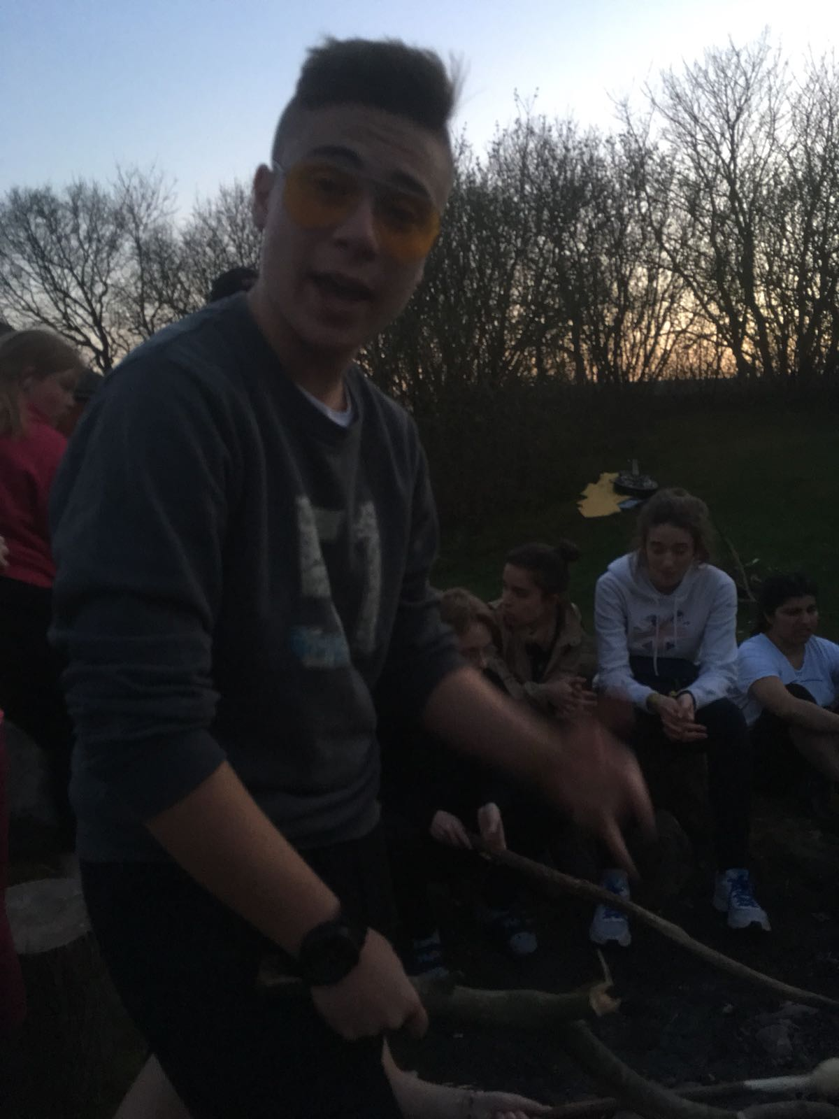
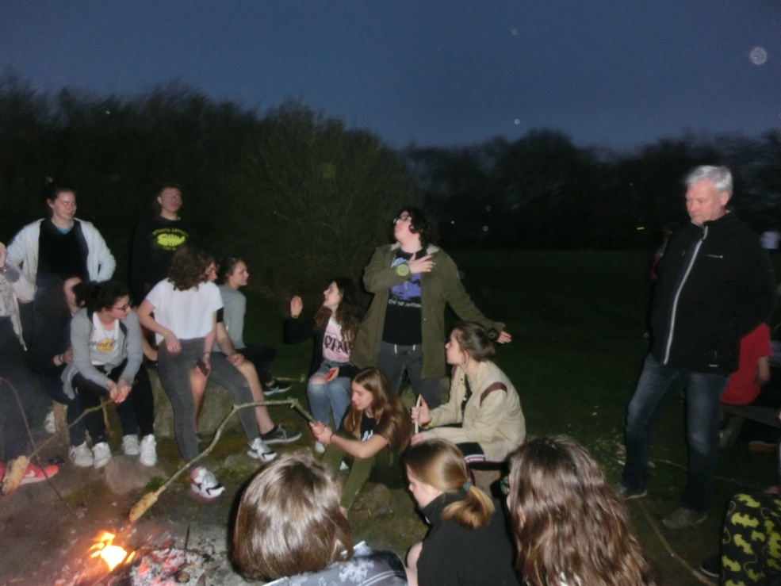
That evening was fantastic, like all the stay in Skovlund Efterskole

Slide 8
REALIZED BY CONTINI MARIA, COPPI ANNALISA AND DAROSI ANGELICA

