Slide 1
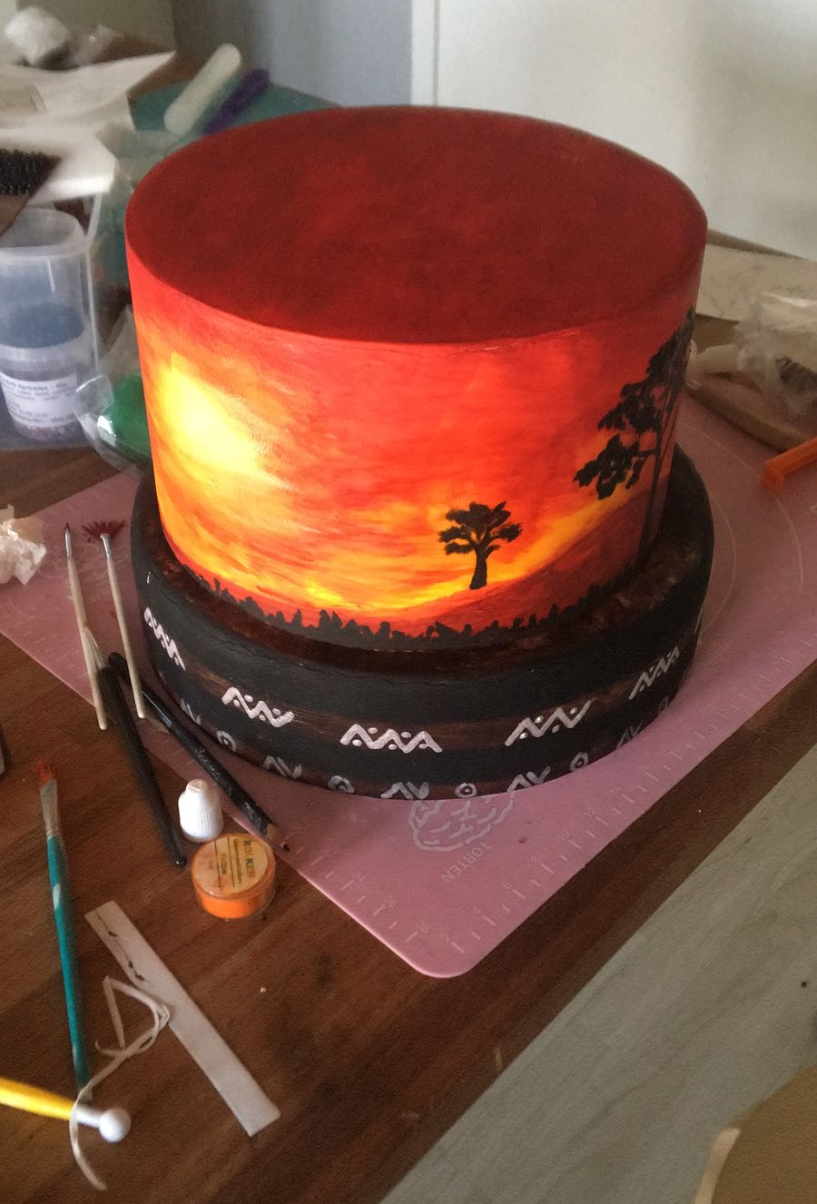
Cake Design with Michelle
While the others were playing, we worked hard!
I’m kidding

Slide 2
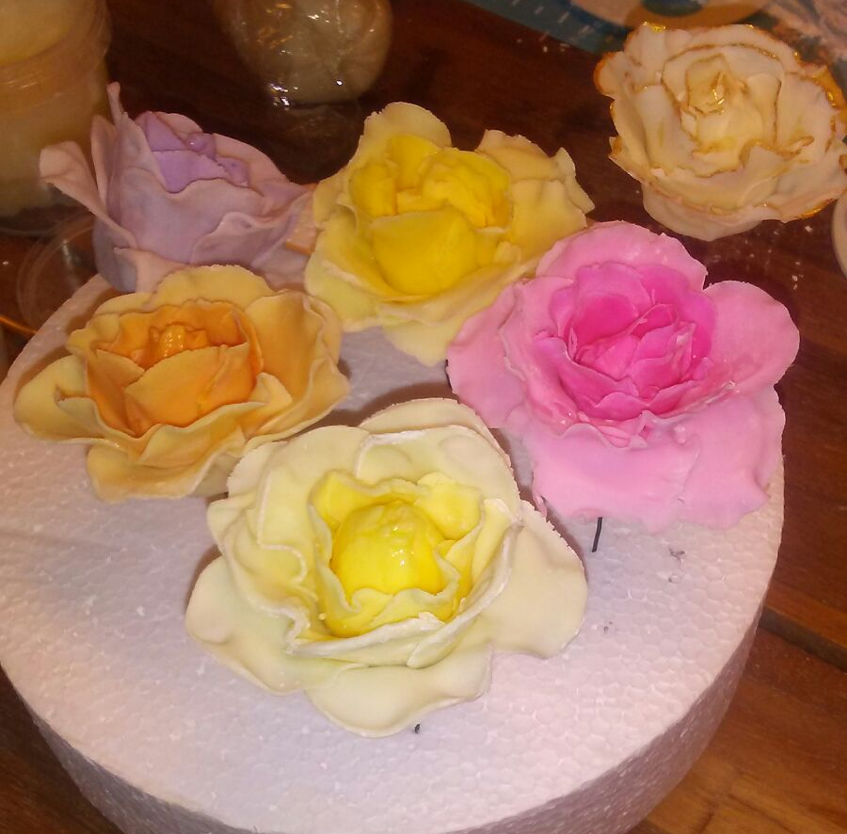
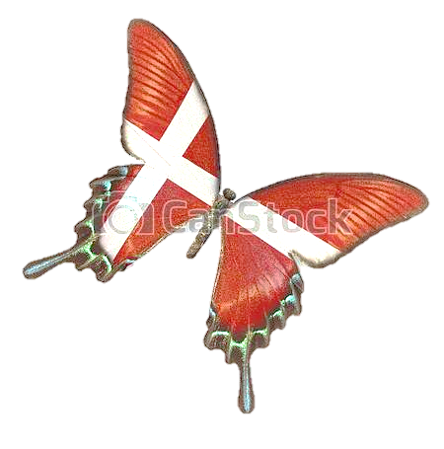
In this Danish exchange we made very many new experiences.
While the others were playing in the park, we had the opportunity to attend cake design lessons.
In fact at Skovlunde Efterskole students may also have cooking lessons and we were pleased to take part in three of them.
So after dinner, the seven of us went to Michelle’s ‘’ garage’’.

Slide 3
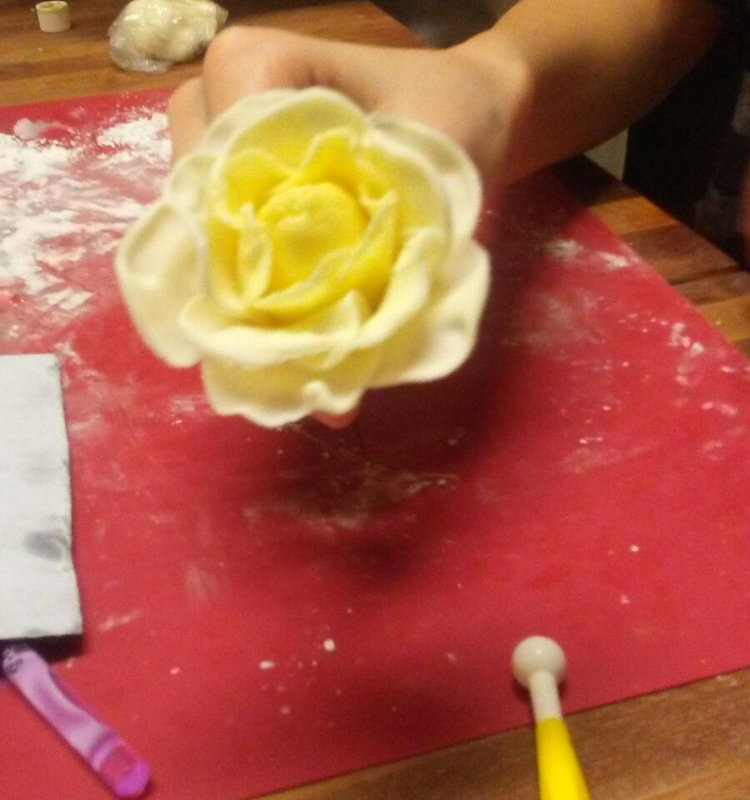
Michelle taught us how to make a sugar rose and widely coloured birds.
We have learned some basic grounding for decorations of cake, which we can also replicate at home (in order to make our meals even good looking).
She and the other students were very skilled in ‘’playing’’ with sugar (they also showed us some of their previous creations).
But we admired Michelle especially as a person: she was very nice and patient with us.
But she didn’t end up just with that: even from the very beginning she made us feeling not judged for our mistakes, which, according to her, are what make people who they really are.

Slide 4
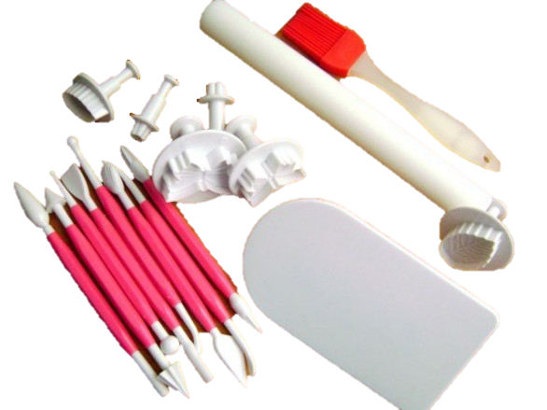
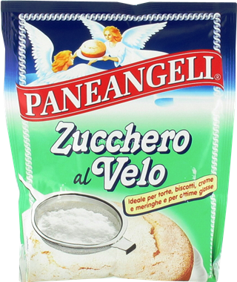
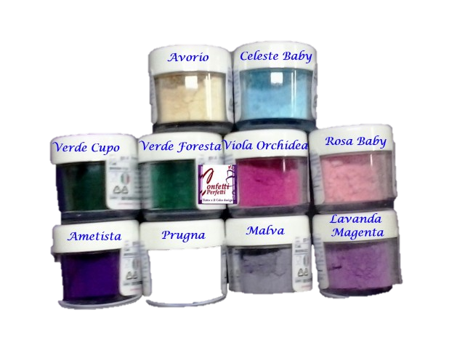
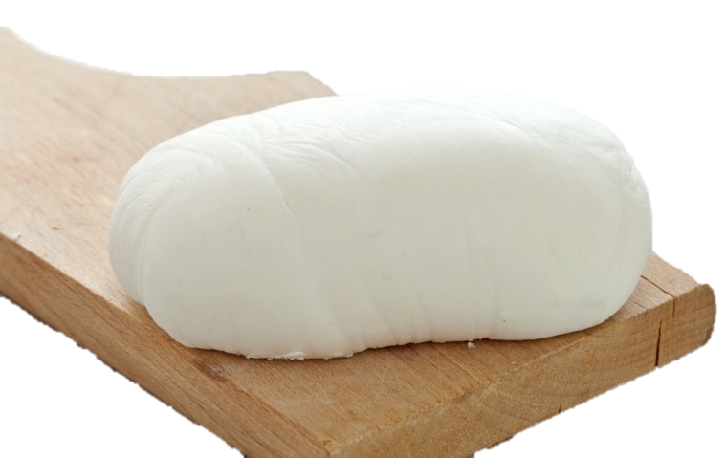
To begin with, we needed some tolls, which we used and learned to use properly (hope so ☺)

Slide 5
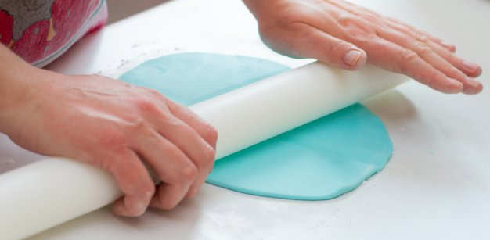
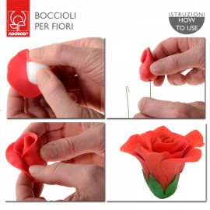
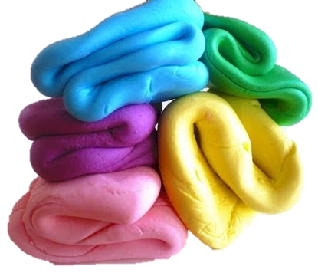
HOW DID WE PROCEED?
We took some fondant and we coloured it.
Then we rolled out the dough and cut a shape of flower.
In order to give them a natural figure, we made ripples on the edge of petals.
Finally we put it around a fake styrofoam bossom.
2
3
4

Slide 6
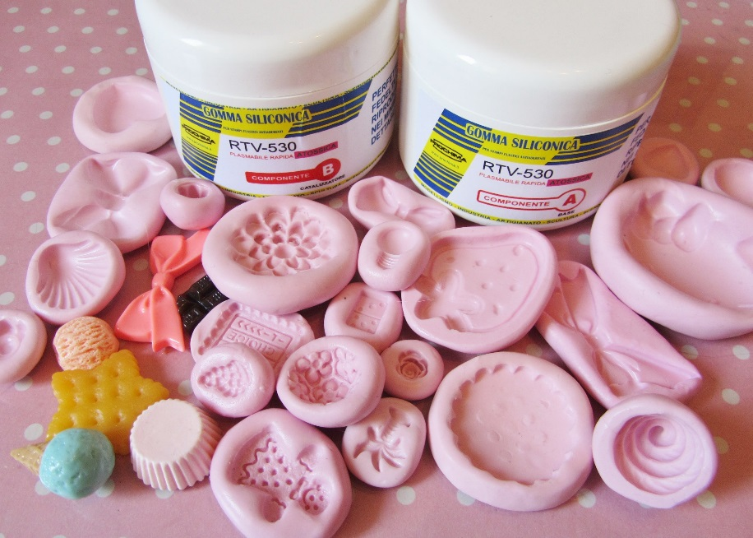
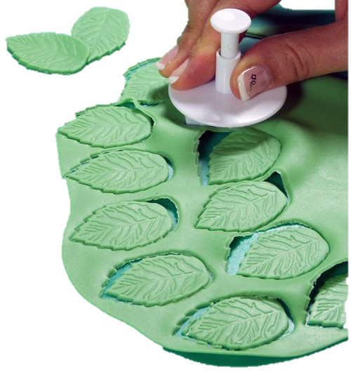
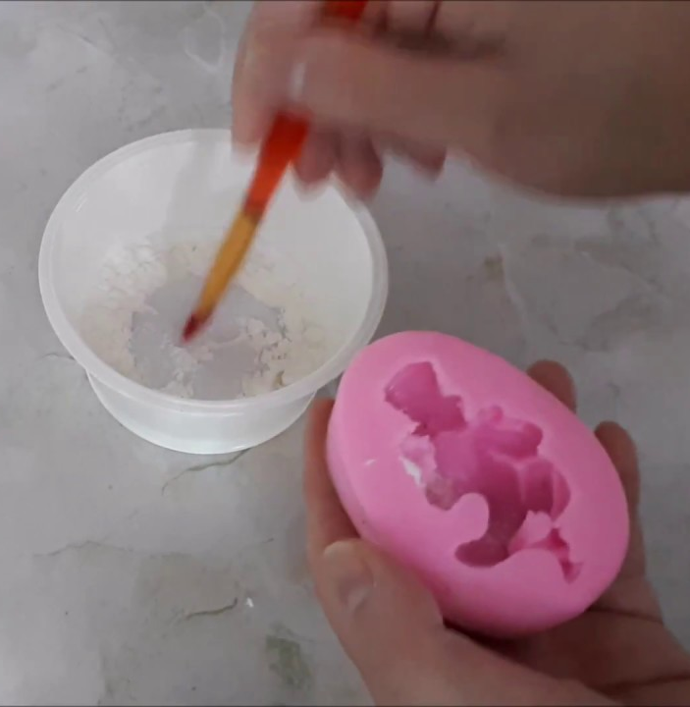
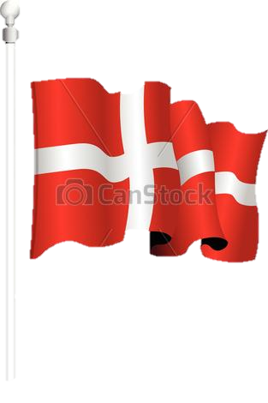
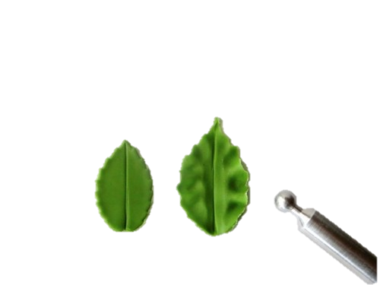
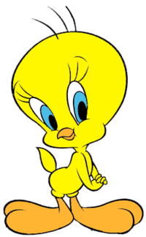
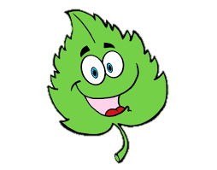
Finally our leaves…
…and birds using molds

Slide 7
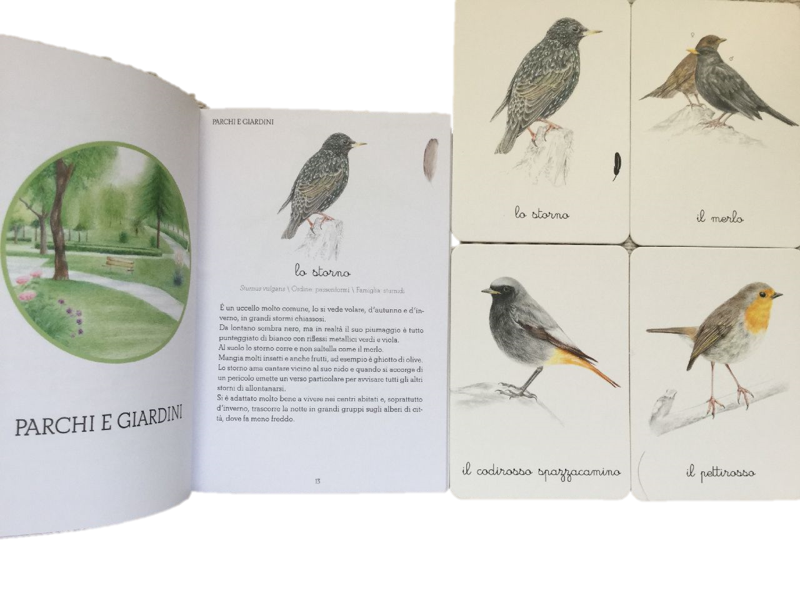
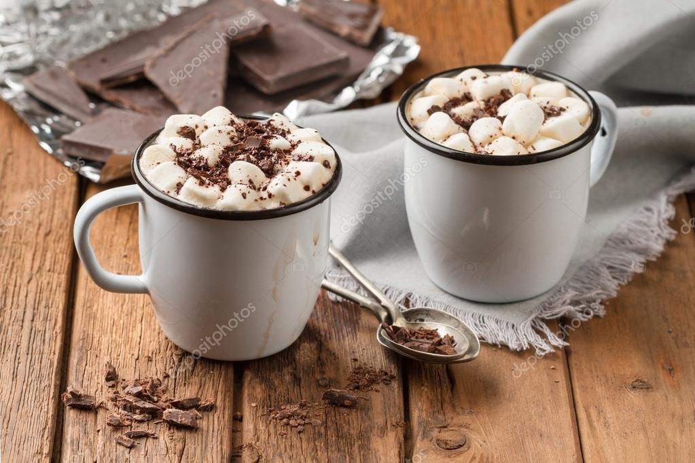
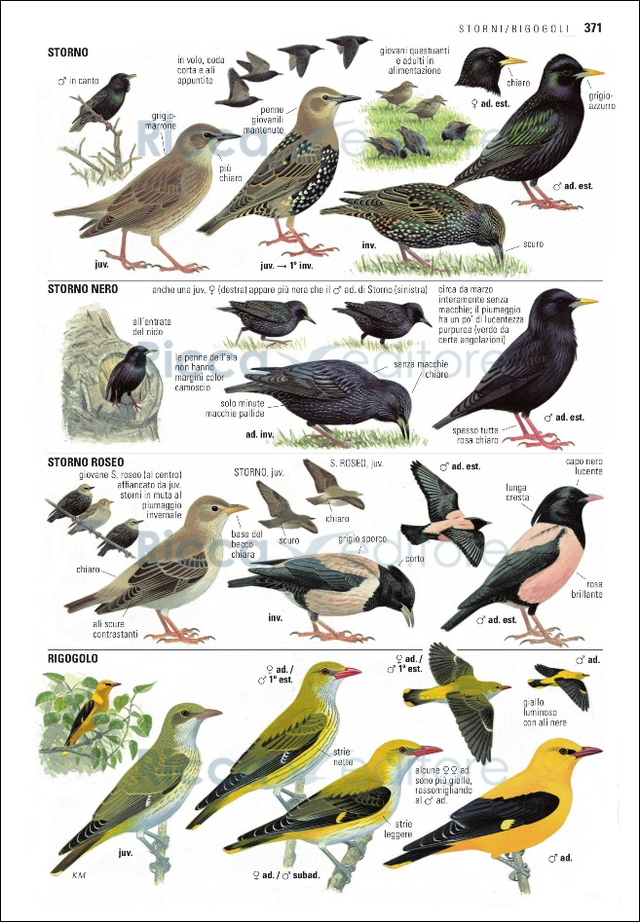
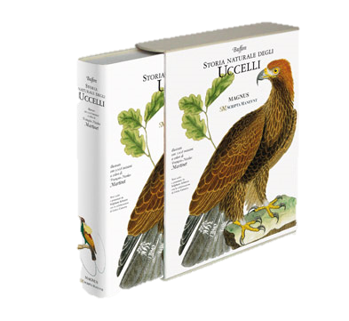
Trying to find inspiration for our birds in books…

Slide 8
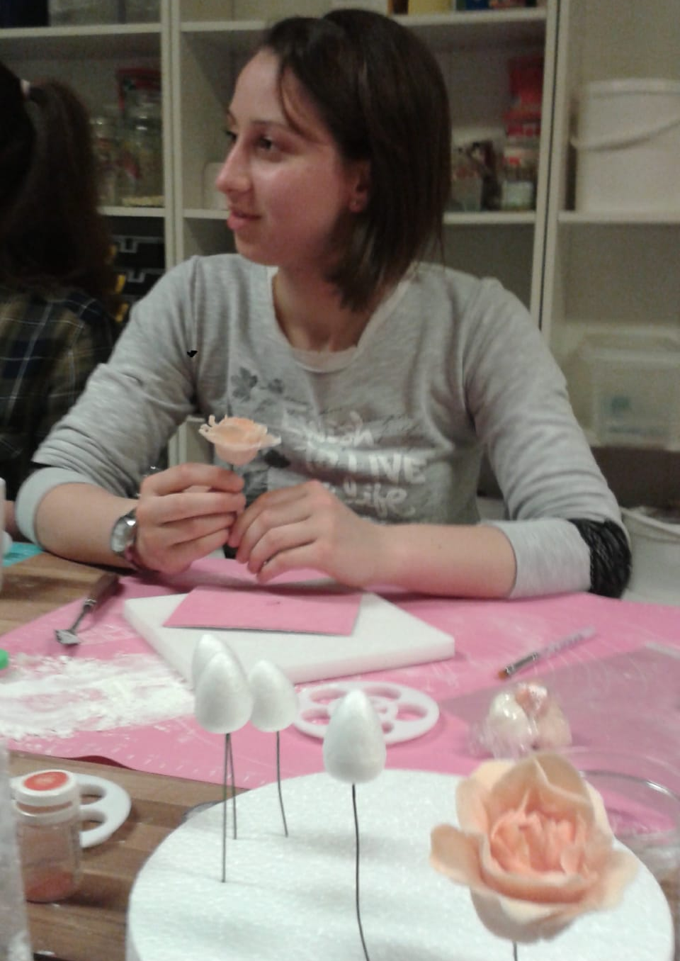
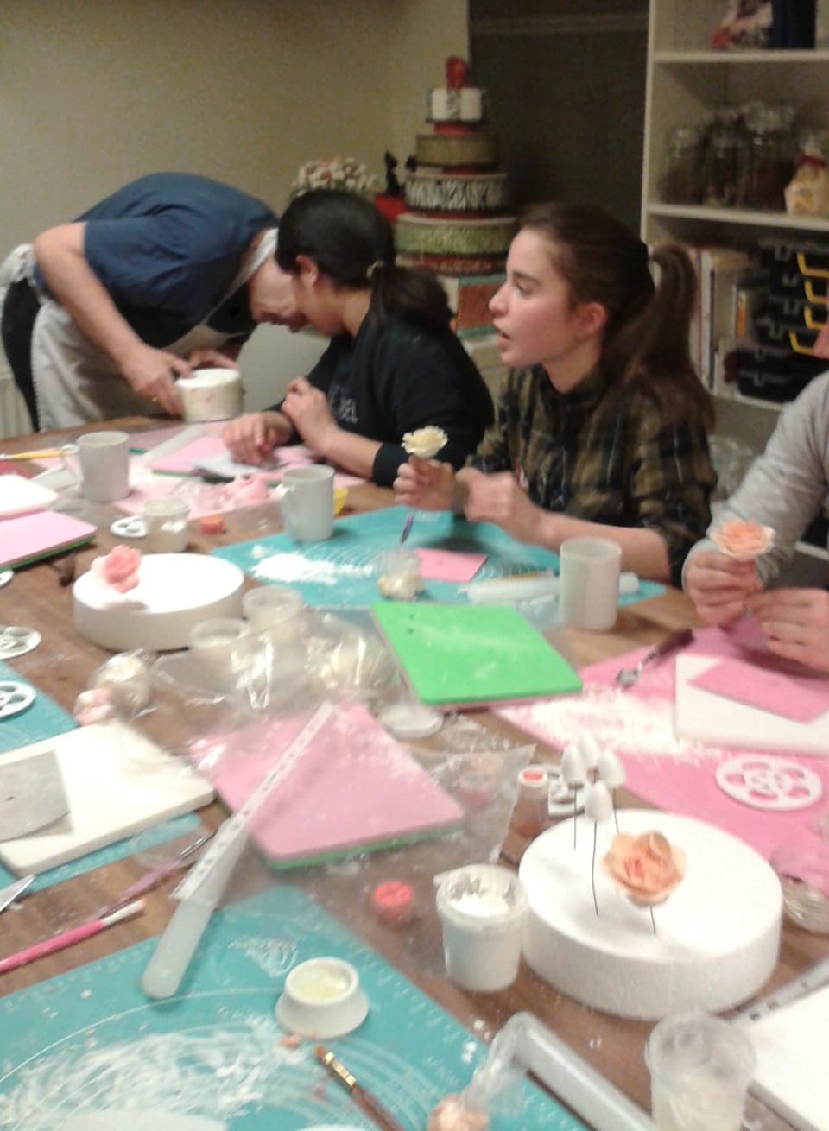

Slide 9
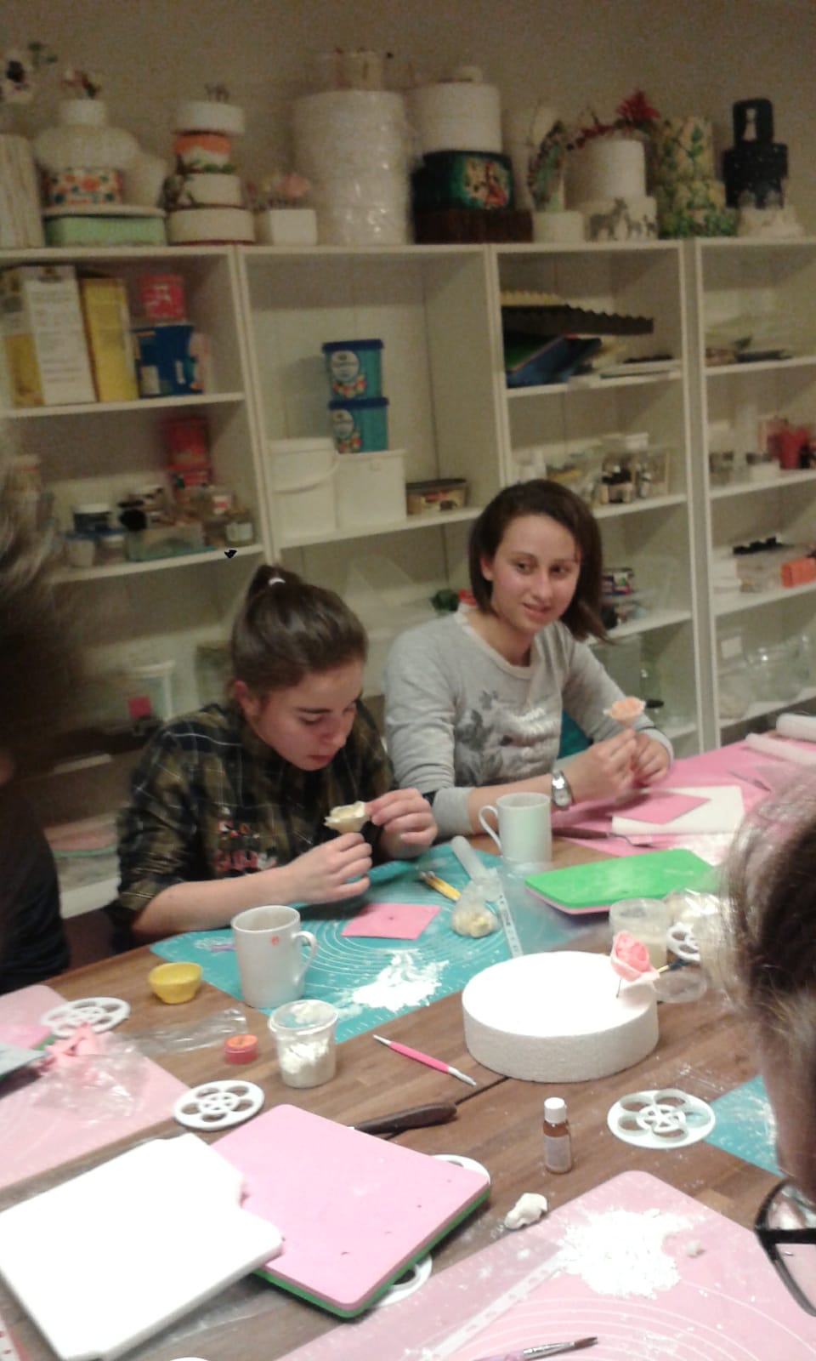
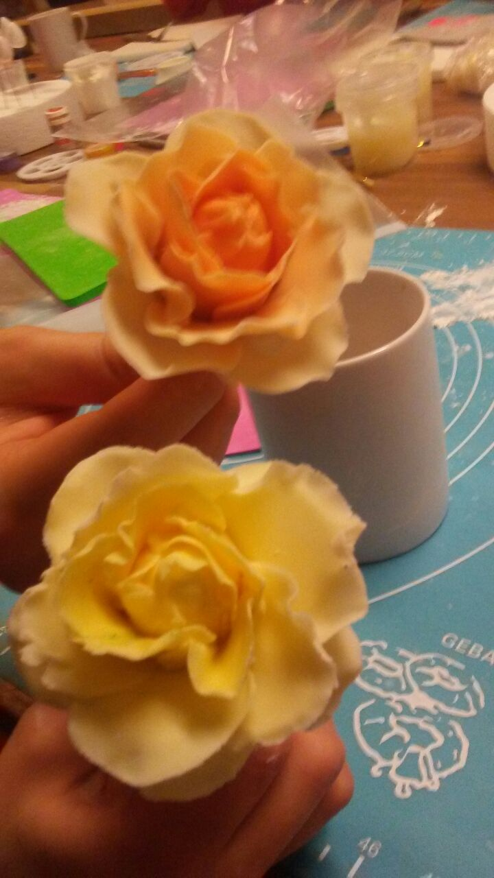

Slide 10
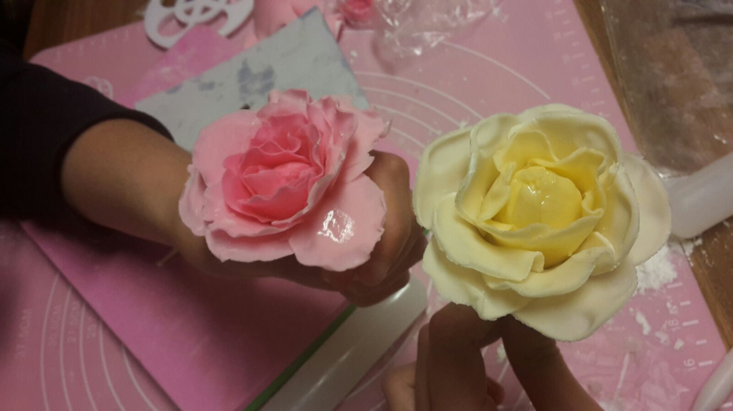

Slide 11
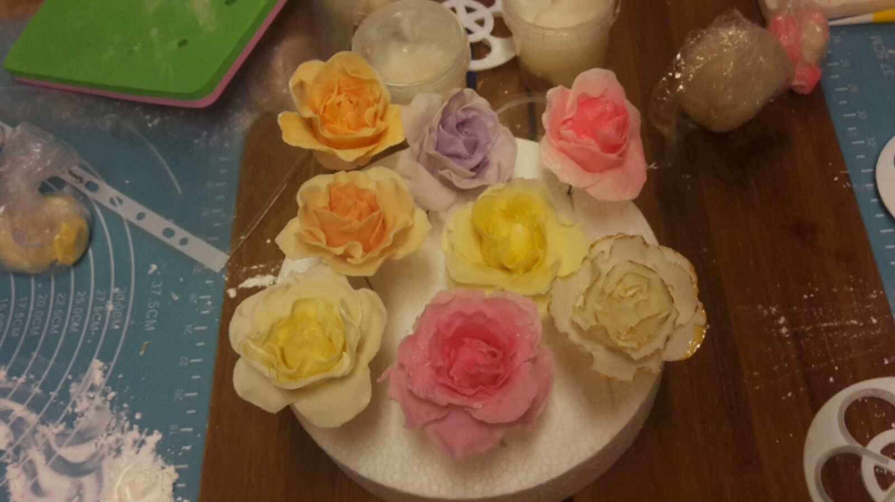
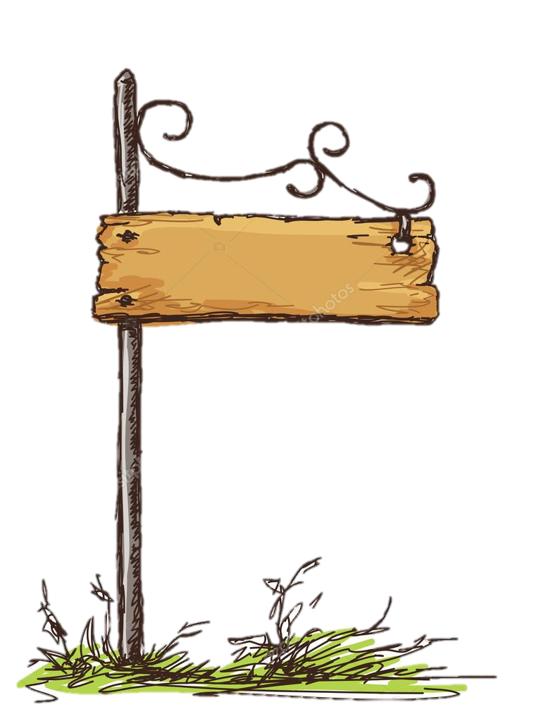
OUR ROSES

Slide 12
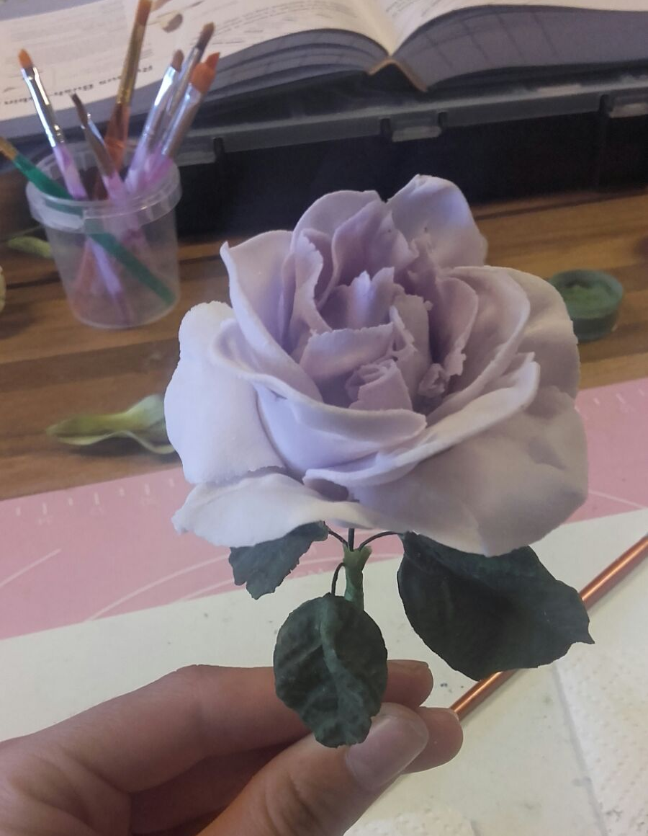
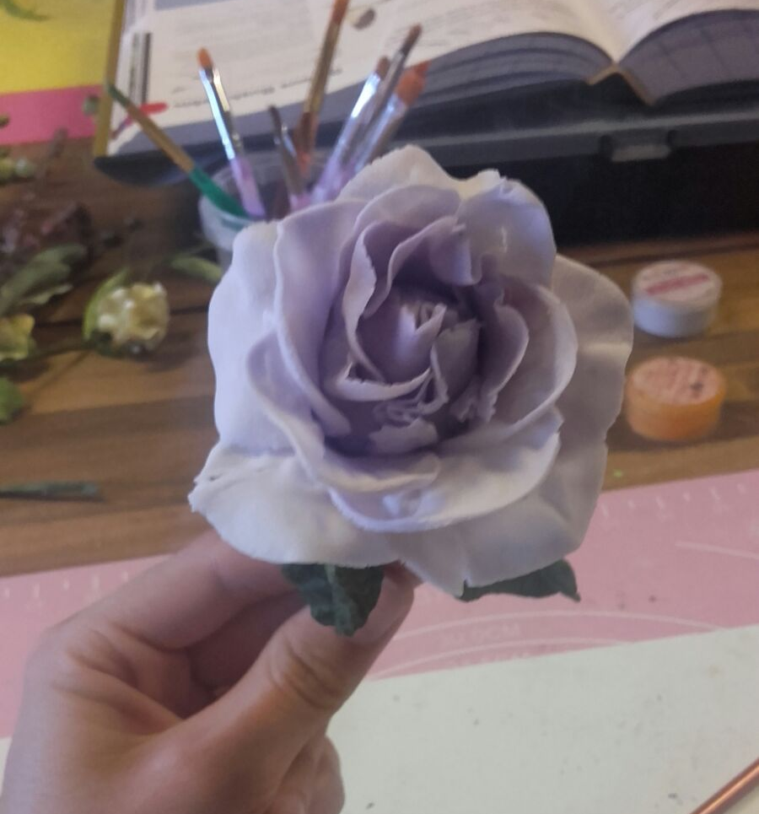
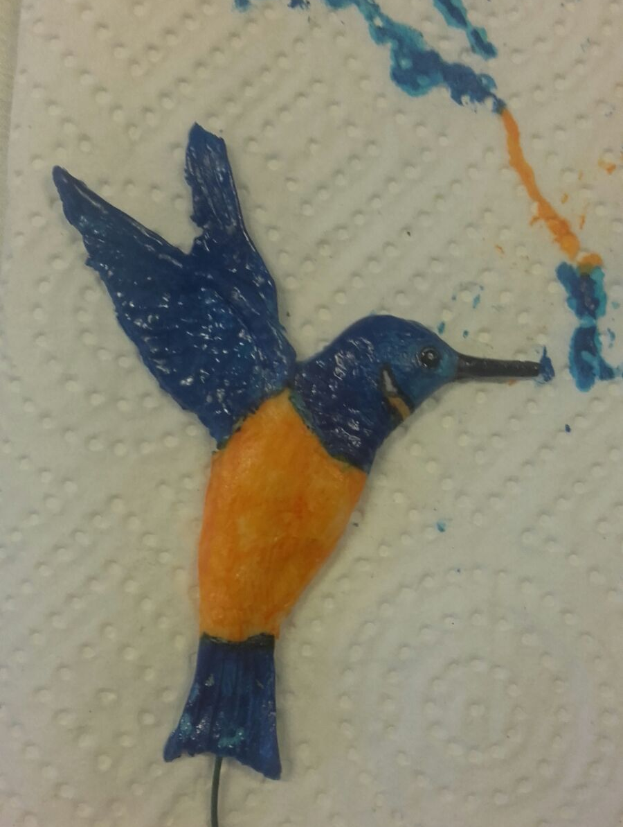
By Micaela

Slide 13
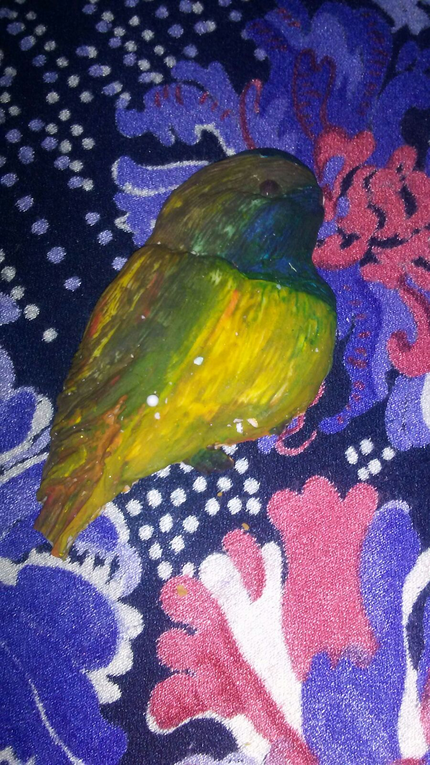
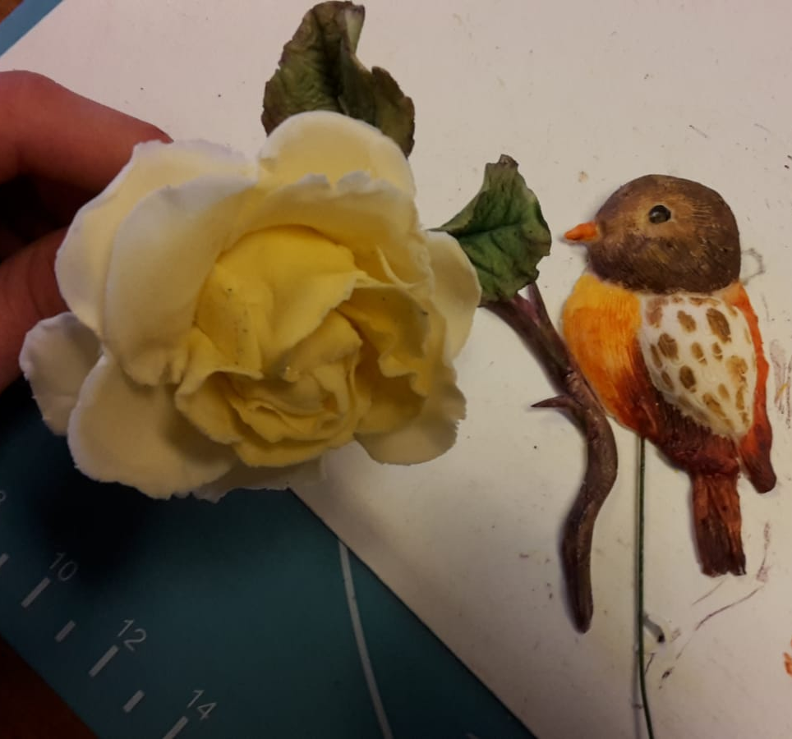
By Viola
By Simona

Slide 14
By Silvia

Slide 15
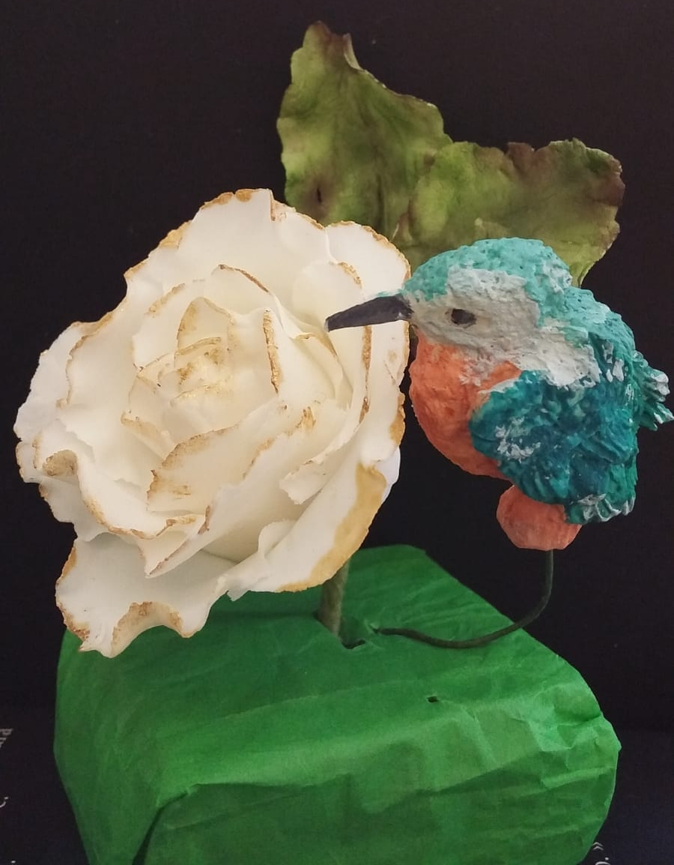
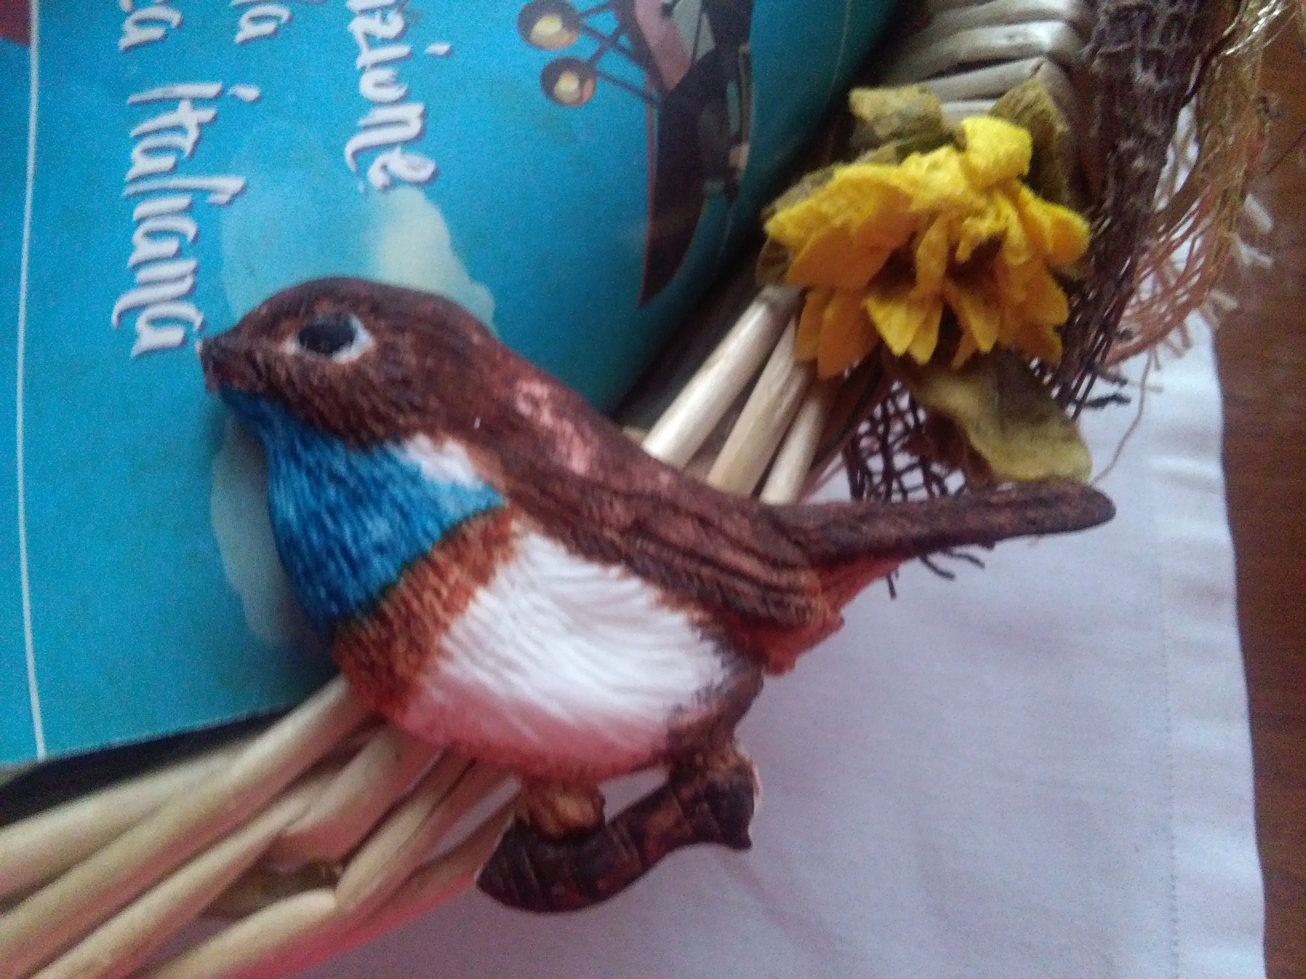
By Annalisa
By Lucrezia

Slide 16
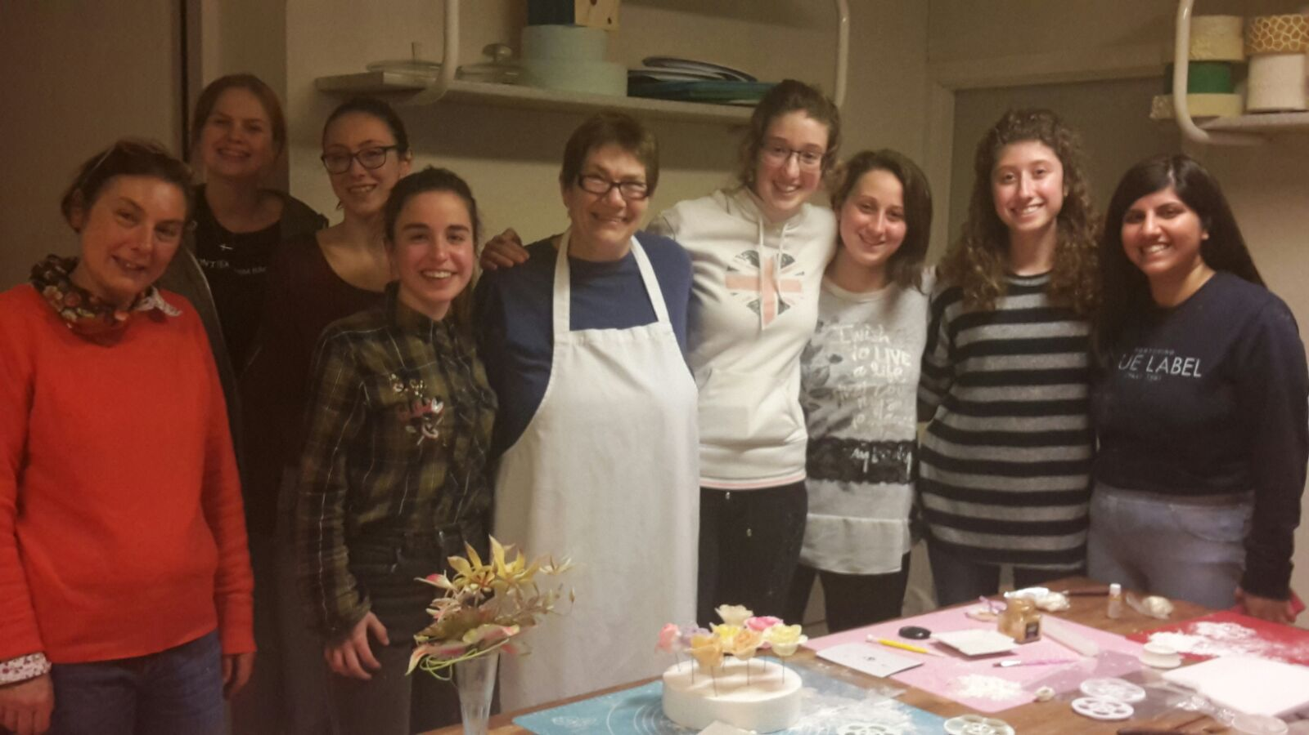

Slide 17
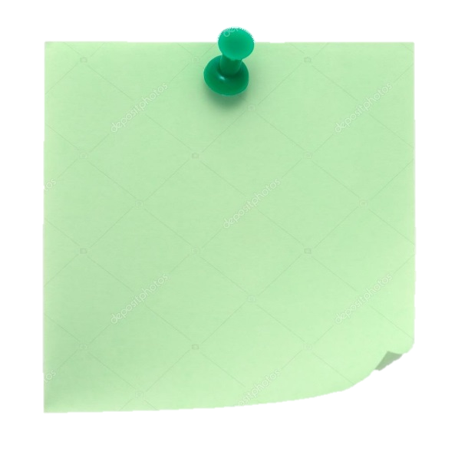
Presented by:
Prestini
Lucrezia
Vaccari Viola
Venturini
Lorenzo

