Slide 1
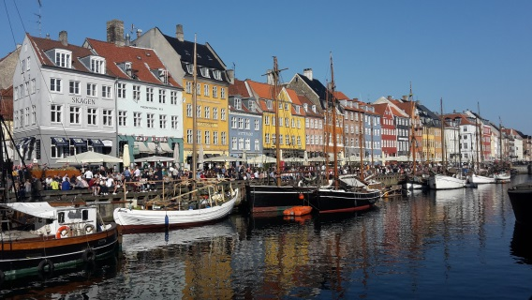
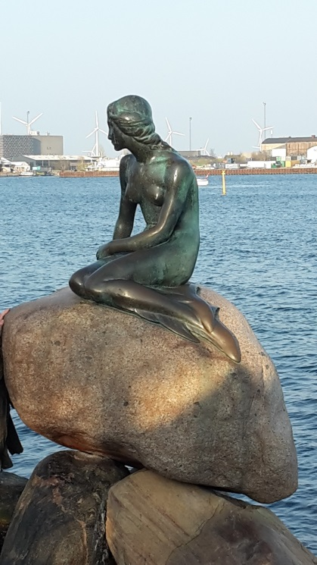
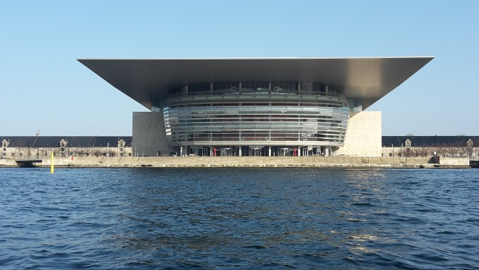
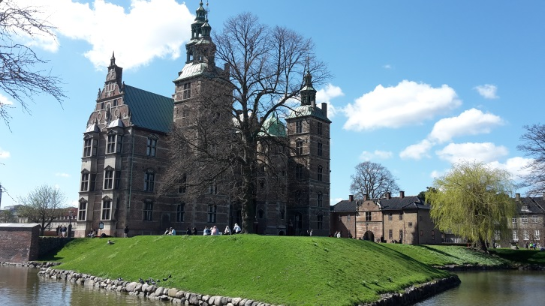
Copenaghen

Slide 2
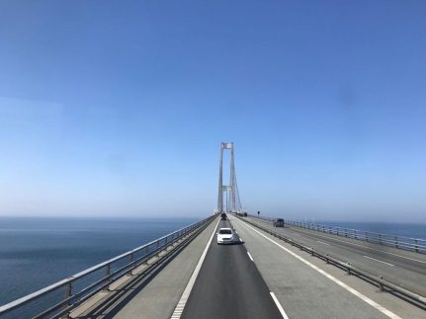
20
APRIL
1st DAY
On the way to Copenhagen we crossed a very long bridge on the sea, as you can see from this picture

Slide 3
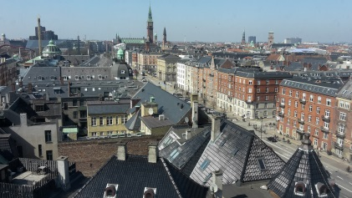
When we arrived in the city by train in the afternoon, first we went to our hotel that was quite near downtown and train station.
In the picture you can see the suggestive view of the city from our rooms.

Slide 4
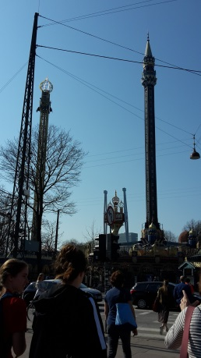
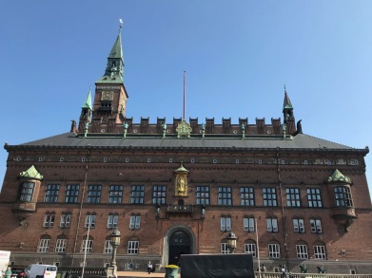
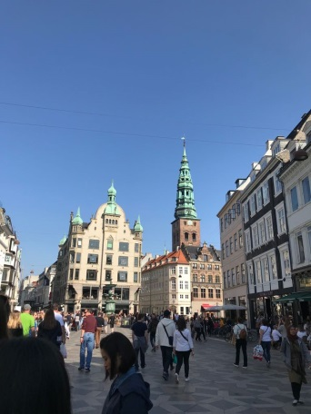
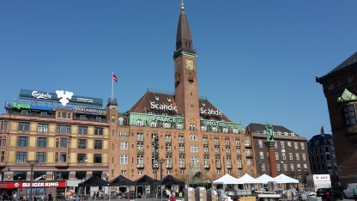
After about half an hour we went out and we started visited the main roads and squares in the downtown

Slide 5
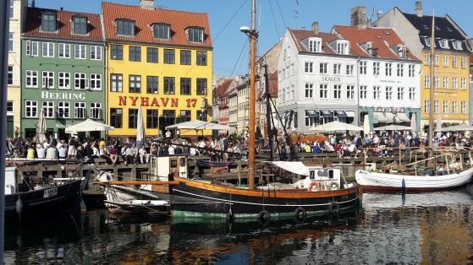
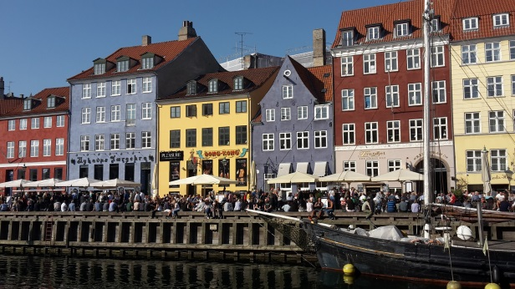
Later we went to Nyhavn Canal where there are a lot of colorful houses along an artificial canal

Slide 6
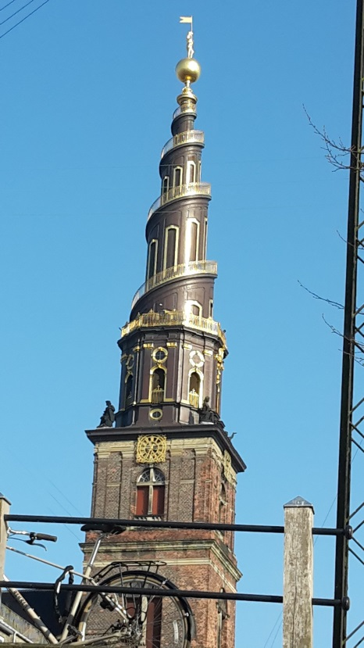
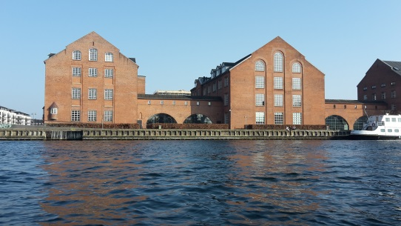
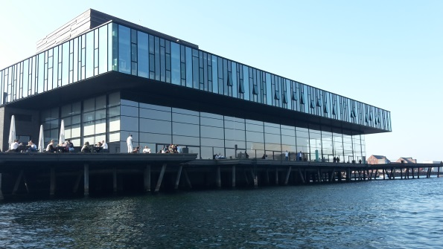
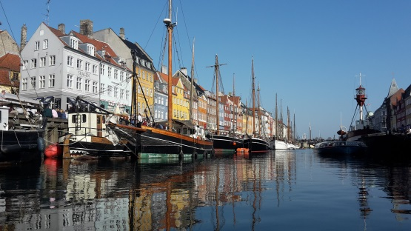
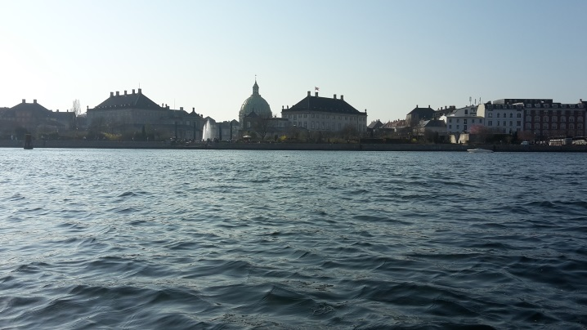
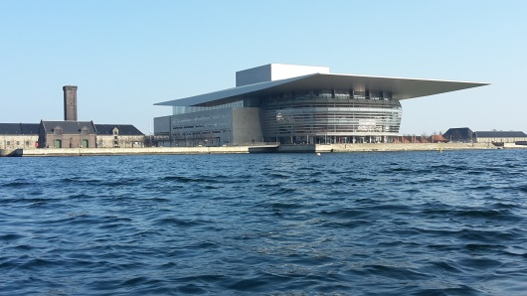
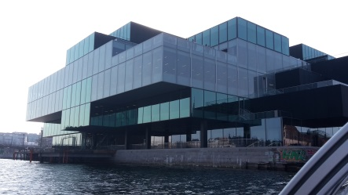
After we did a boat ride for one hour

Slide 7
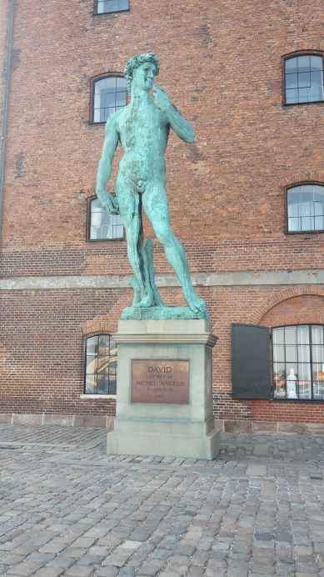
Then we went for a walk around the harbour.
Even though we were far from Italy, we felt anyway at home…
…more or less

Slide 8
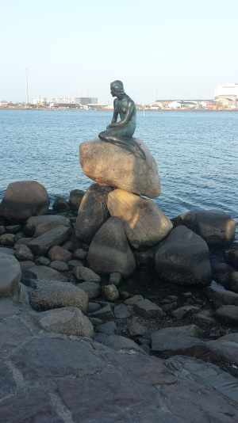
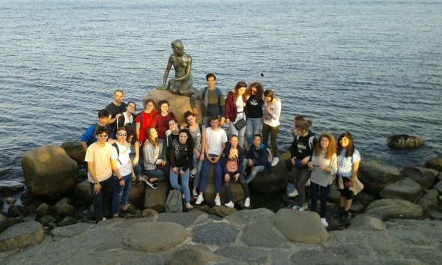
After a walk along the sea, we saw the famous statue of the little mermaid...
...and we took a picture
of our class!

Slide 9
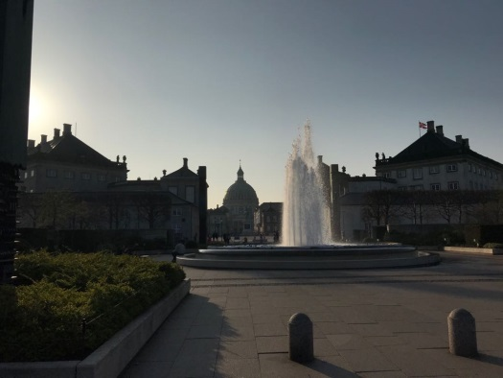
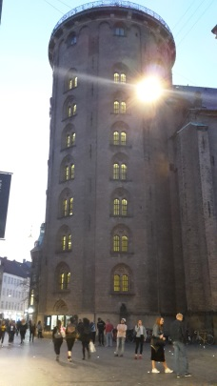
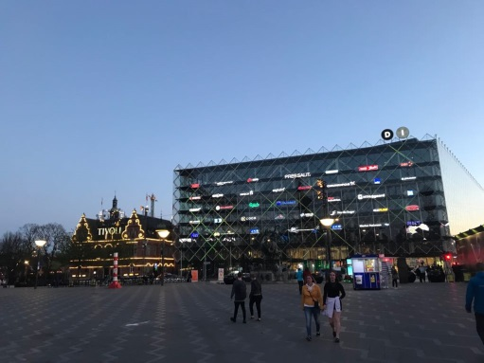
Copenaghen
in the evening
In the top picture there is the Royal Palace with a big fountain in front of that.
In the down photo there is the main square of the city
Rundetårn (Round Tower in English), is a 17th-century tower located in central Copenhagen

Slide 10
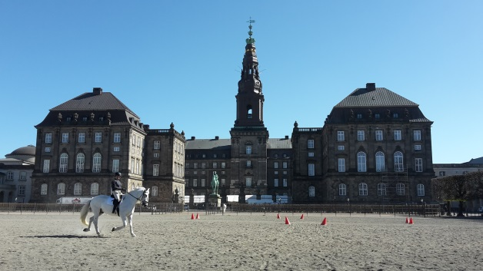
21
APRIL
2nd DAY

Slide 11
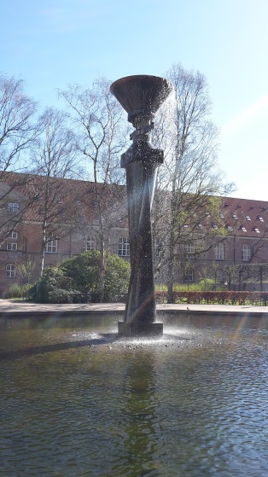
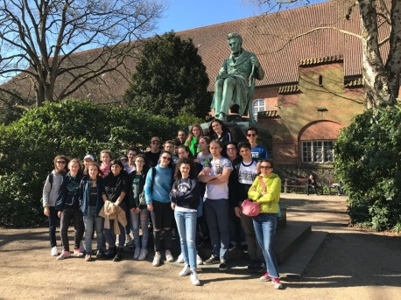
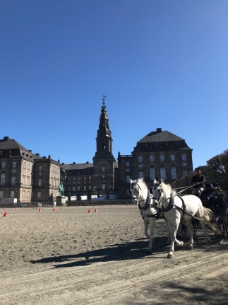
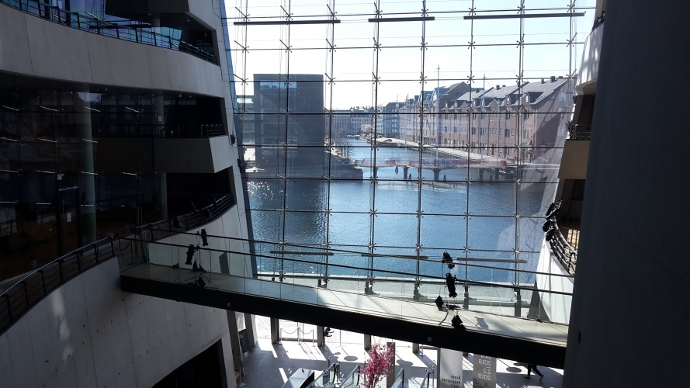
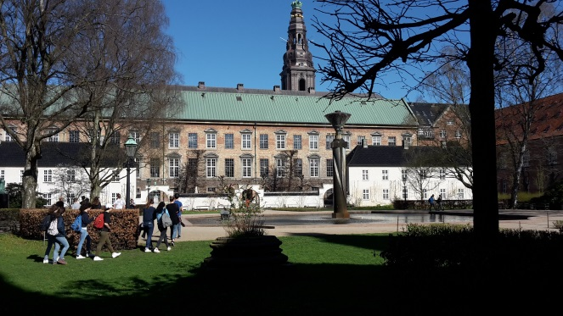
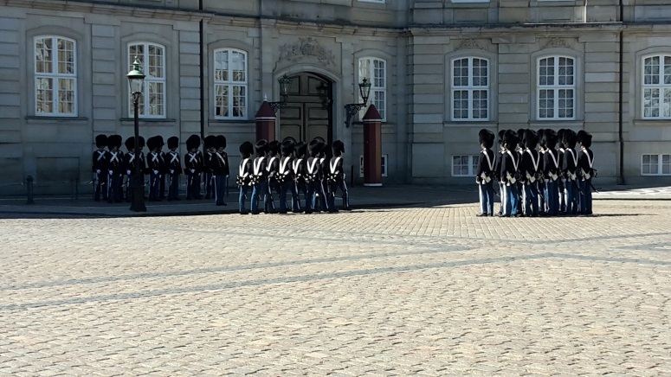
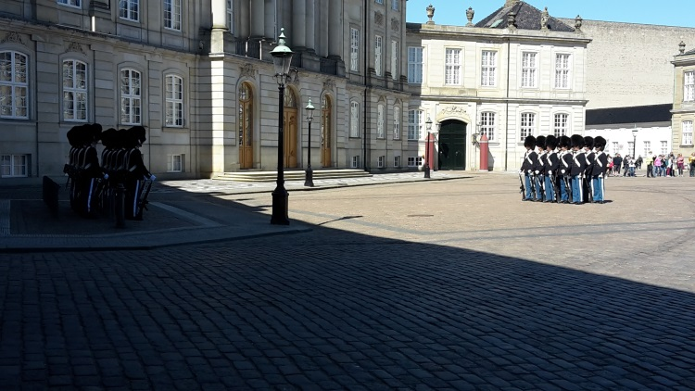
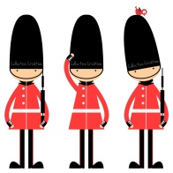
In the morning we saw a part of the
changing of the guard in the square of the royal palace

Slide 12
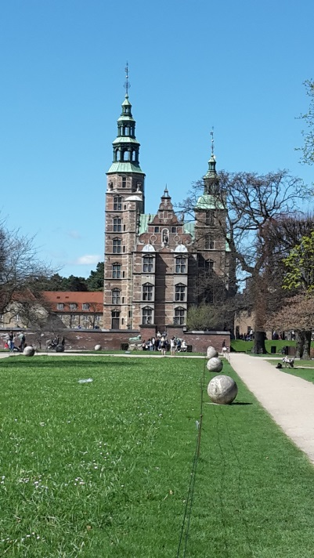
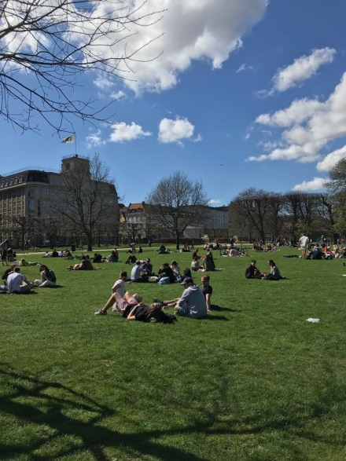
In the afternoon we went to Tivoli park where we could relax and have fun

Slide 13
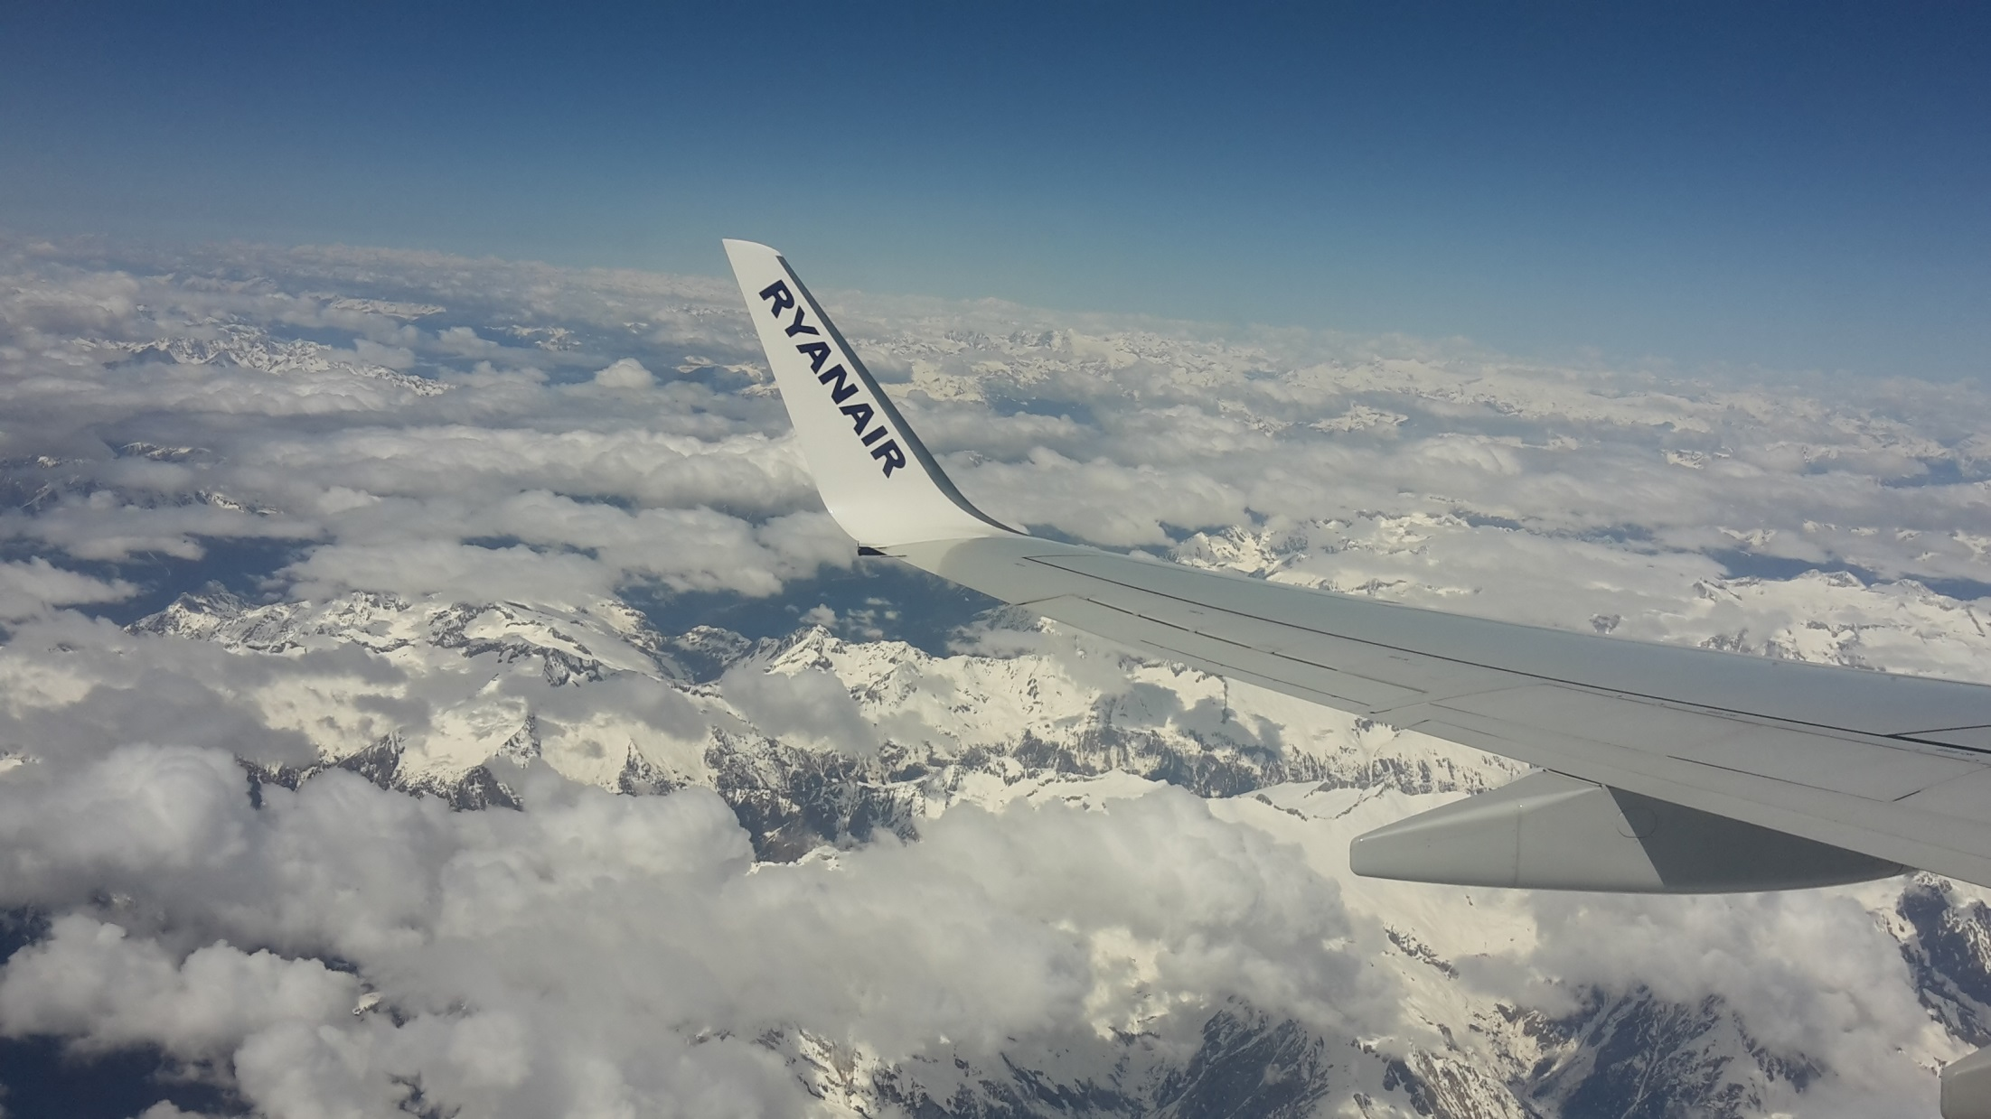
Unfortunately the day after we had to come back to Italy…

Slide 14
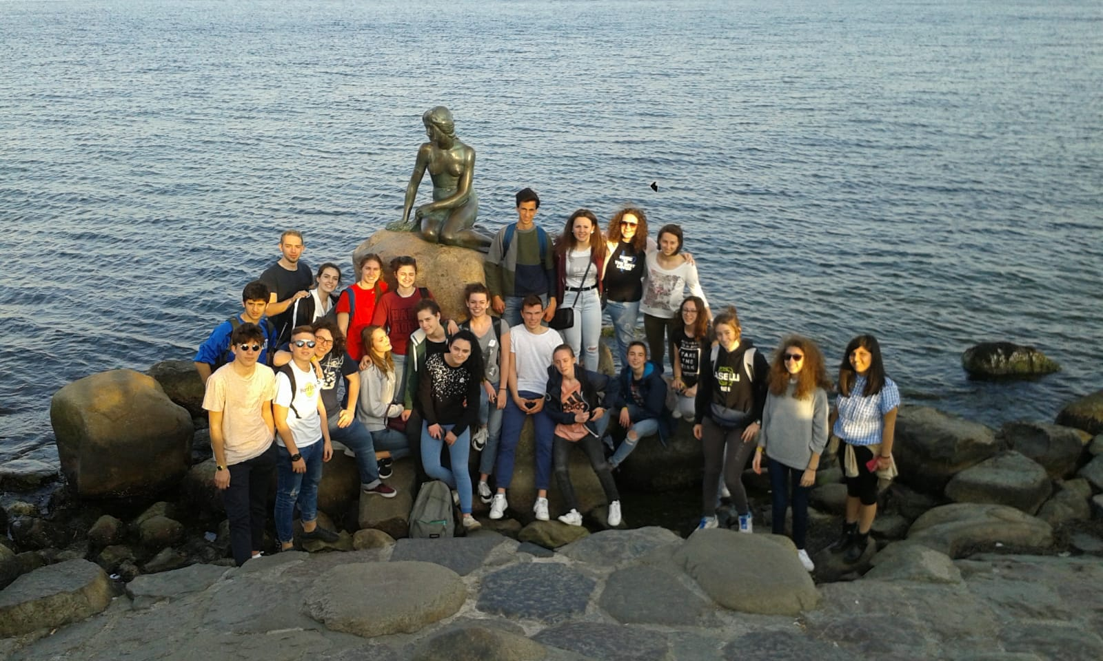
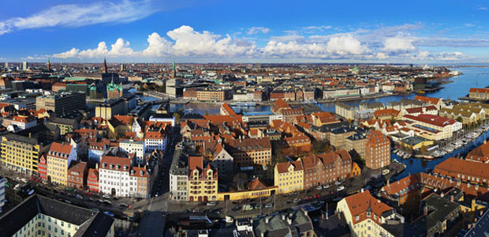
…but we did a beautiful experience, and we had the opportunity to see an amazing european capital.
3C LIC.

Slide 15
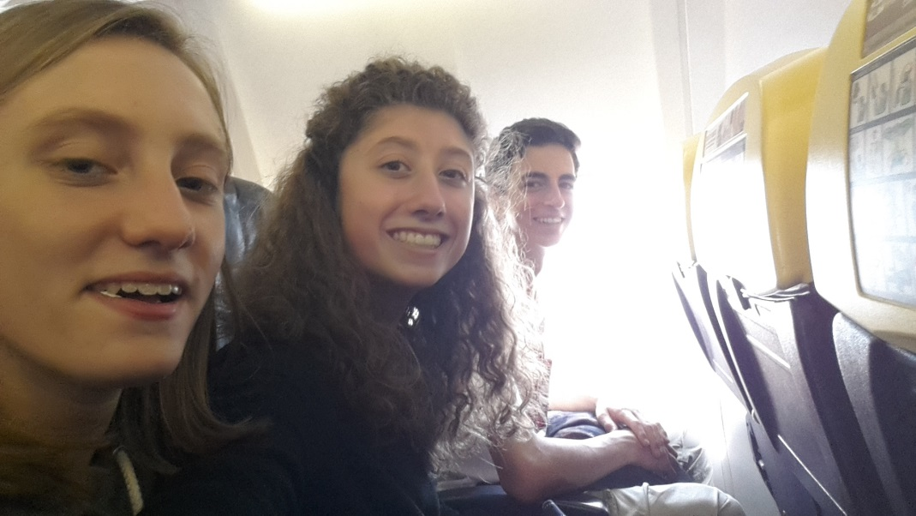
SILVIA MEI
JACOPO MURABITO
FRANCESCA PERCUDANI
3C LIC progetto alternanza scuola lavoro
Copenaghen 2018

