Slide 1
Big Family
to host and be hosted

Slide 2
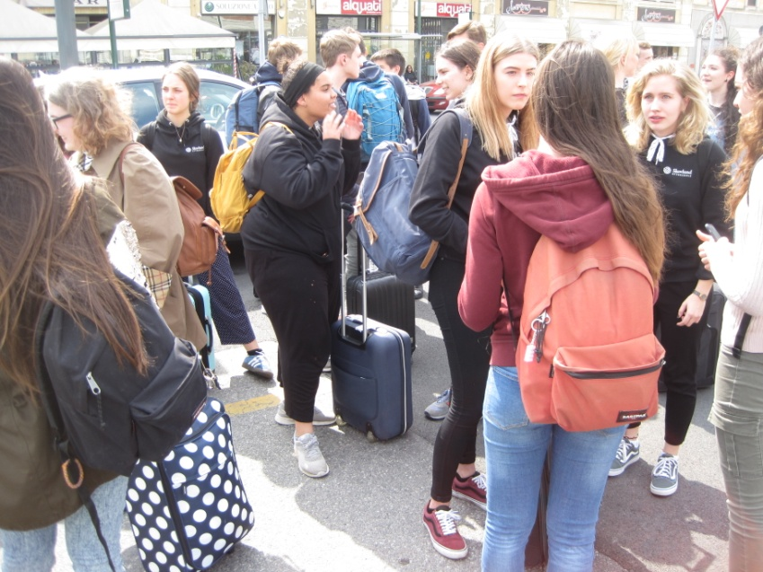
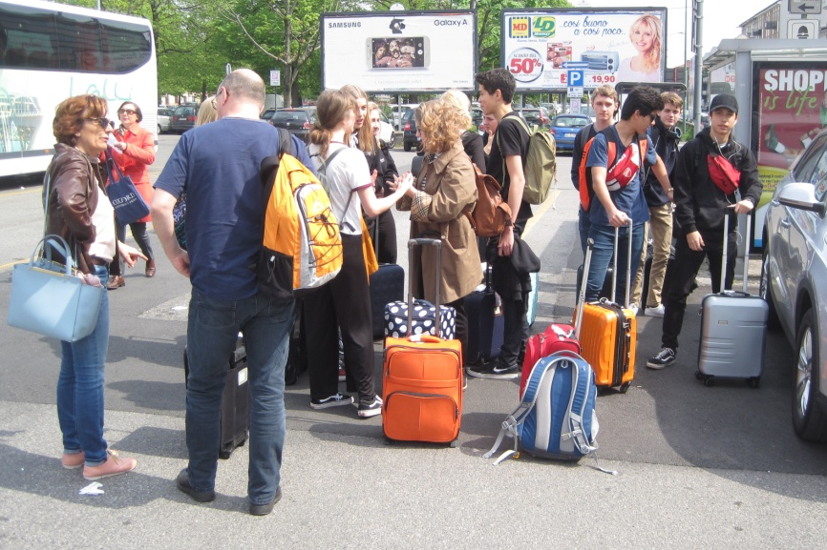
During the exchange, we've been hosting and hosted.
At first Danish students have been welcomed in our families: sixteen italian guys had the oportunity to share their habits with an unusual guest.
Everything started with their arrival in Italy.

Slide 3
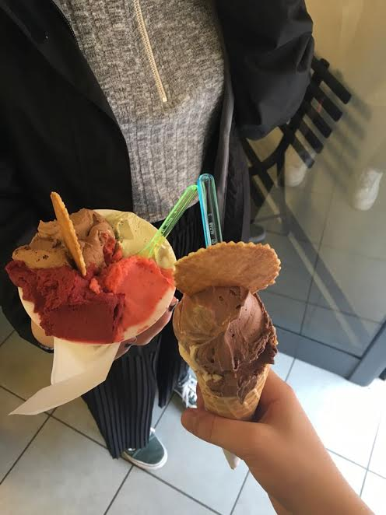
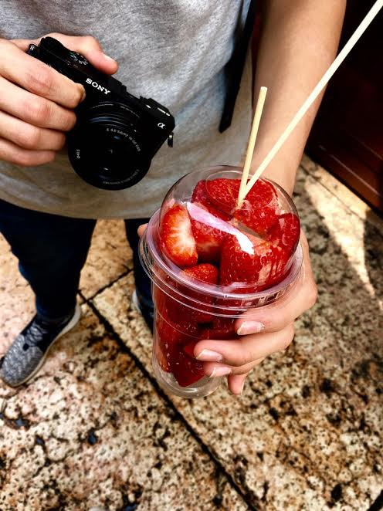
In Italy we had a lot of free time that we used to get to know our guests. We cooked some traditional italian foods like lasagne and pasta which they really appreciated. They liked also our idea of ice cream and fruit.

Slide 4
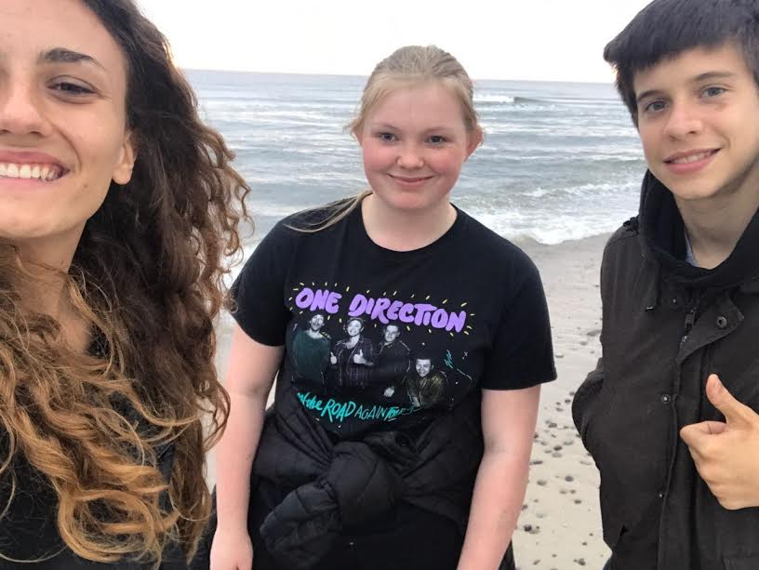
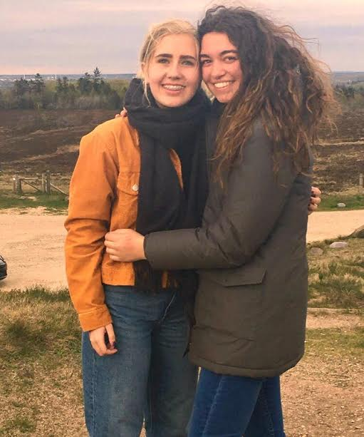
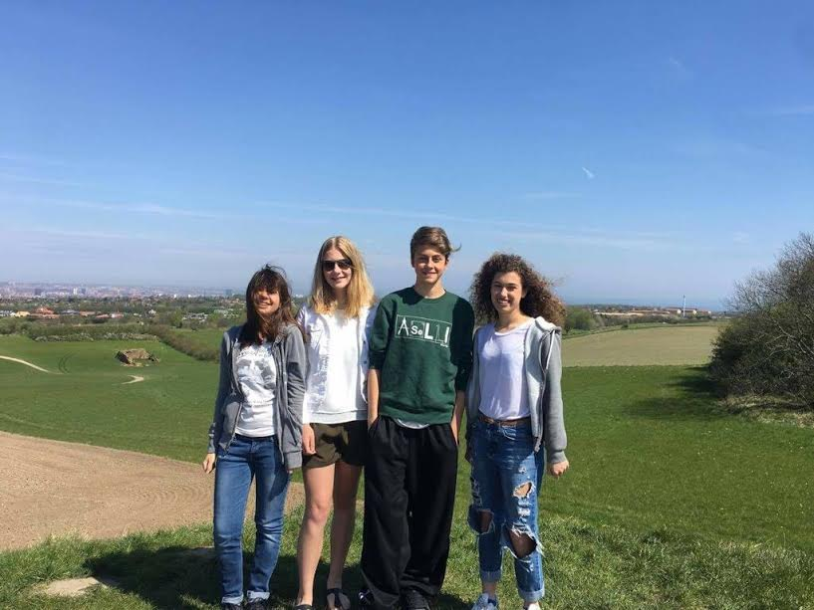
Then, when we went to Denmark, we were hosted by some students' families during the weekend. Most of us were hosted with one italian buddy.
An exception was Marco, who stayed at the boarding school troughout the weekend as Steven's guest.

Slide 5
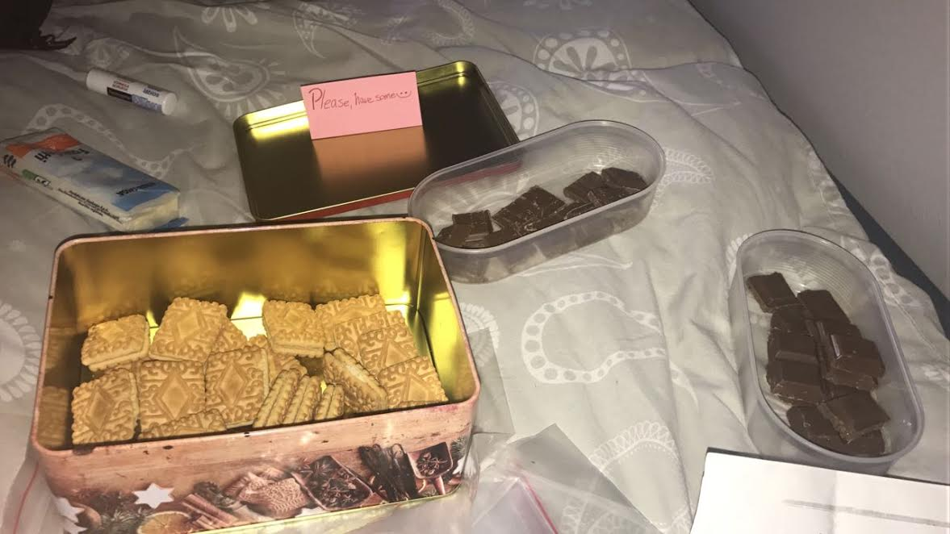
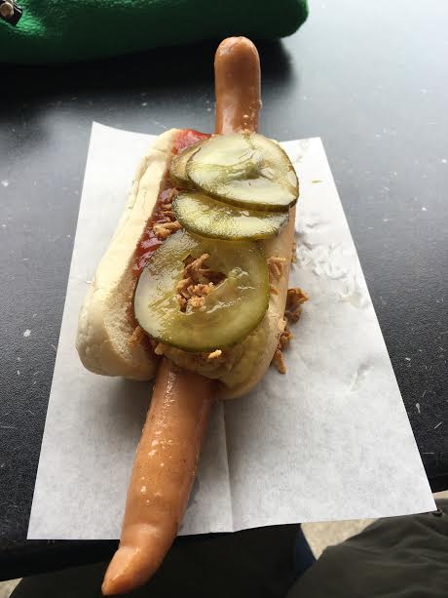
There we enjoyed their traditios, expecially the food. Actually it was good, even though it seemed very different from our cuisine (sometimes even weird).

Slide 6
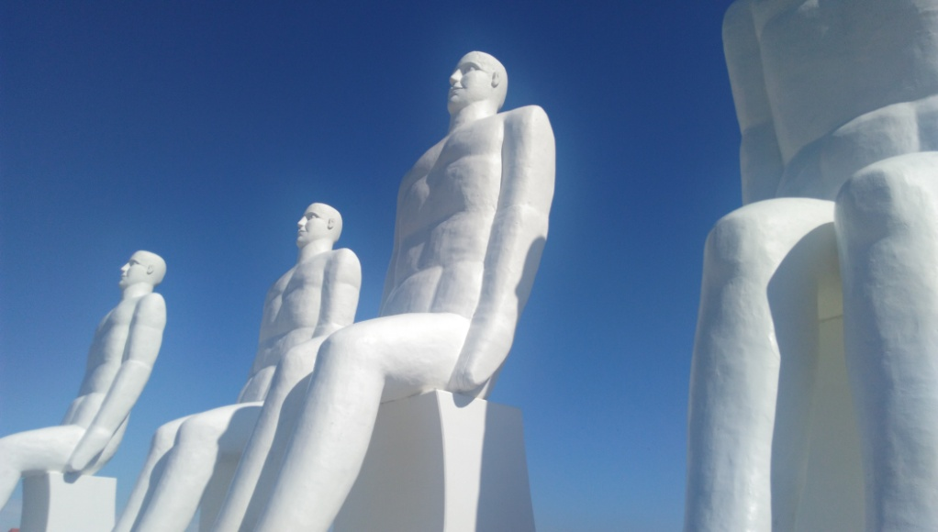
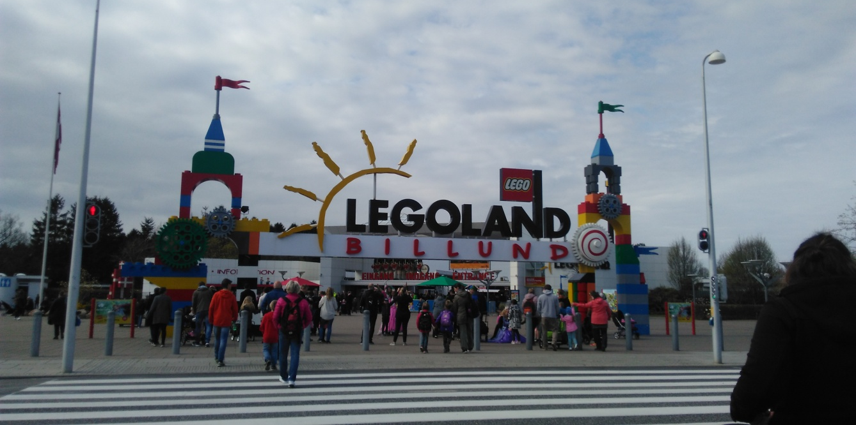
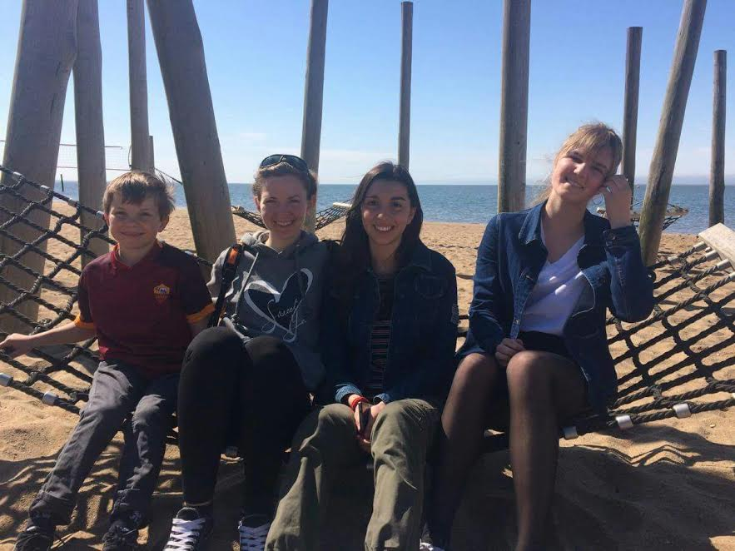
We had a lot of fun thank to all the activities they had planned for us. For example some of us visited the big cities in which they were hosted -like Aahurus and Odense.
Others went to Legoland- the typical leasure park in Denmark- and to the beach, to see the modern sculpture depicting four white men looking at the sea.

Slide 7
The experience was very formative: we learned a lot about Danish customs and traditions, but we also talked about several topics like hobbies... However this enriched our cultur but also improved our English abilities, so that we can say it has been a journey trough which we have strengthened our human and comunicative skills.

