Slide 1
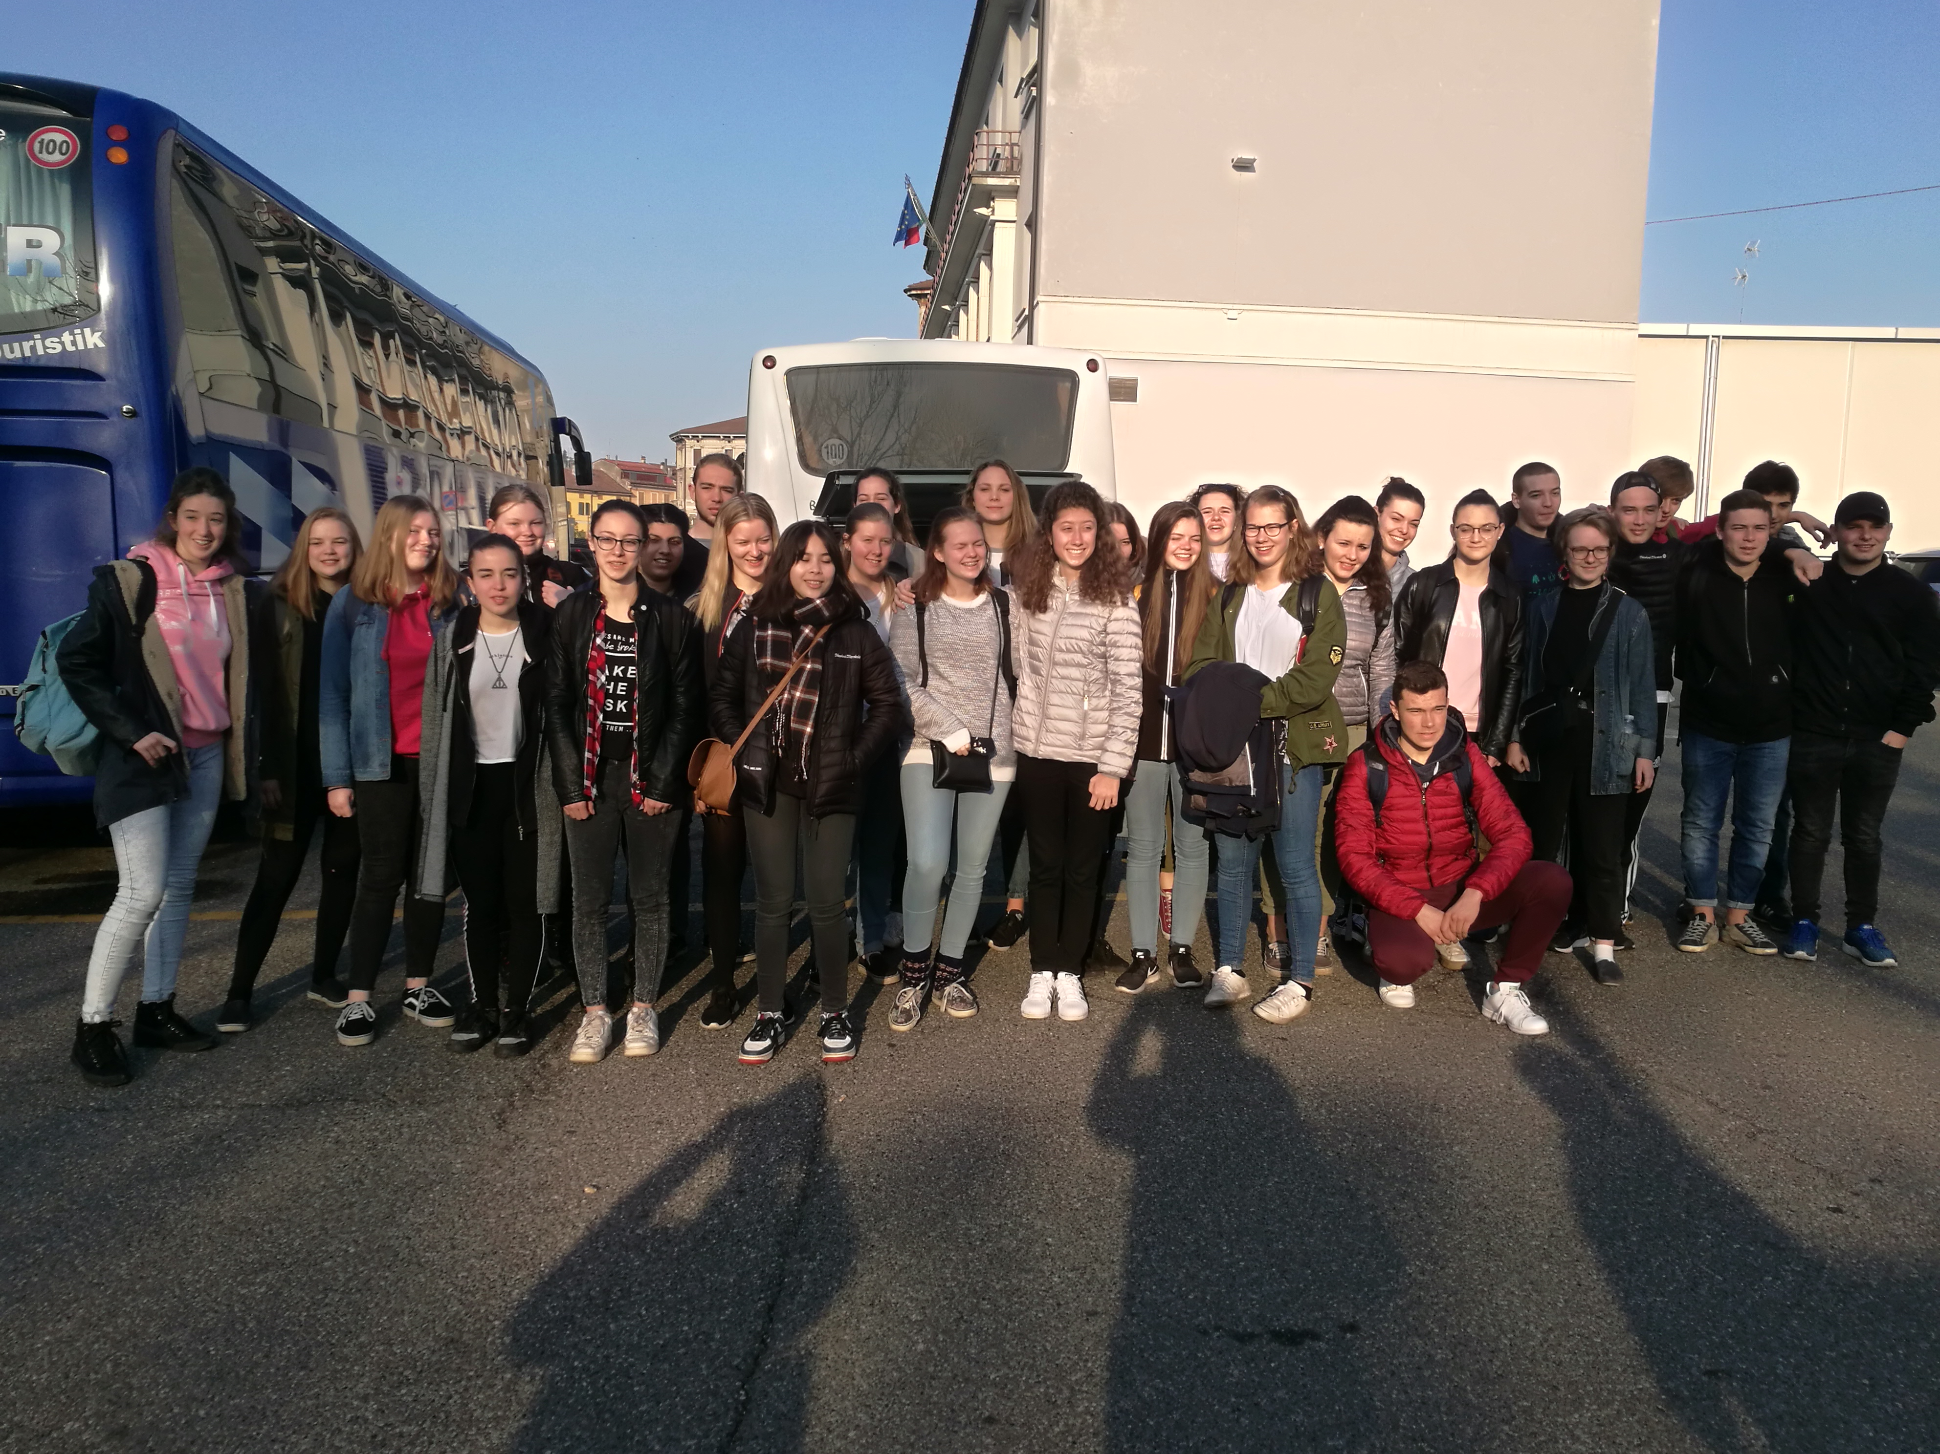
Free time in cremona with danish friends

Slide 2
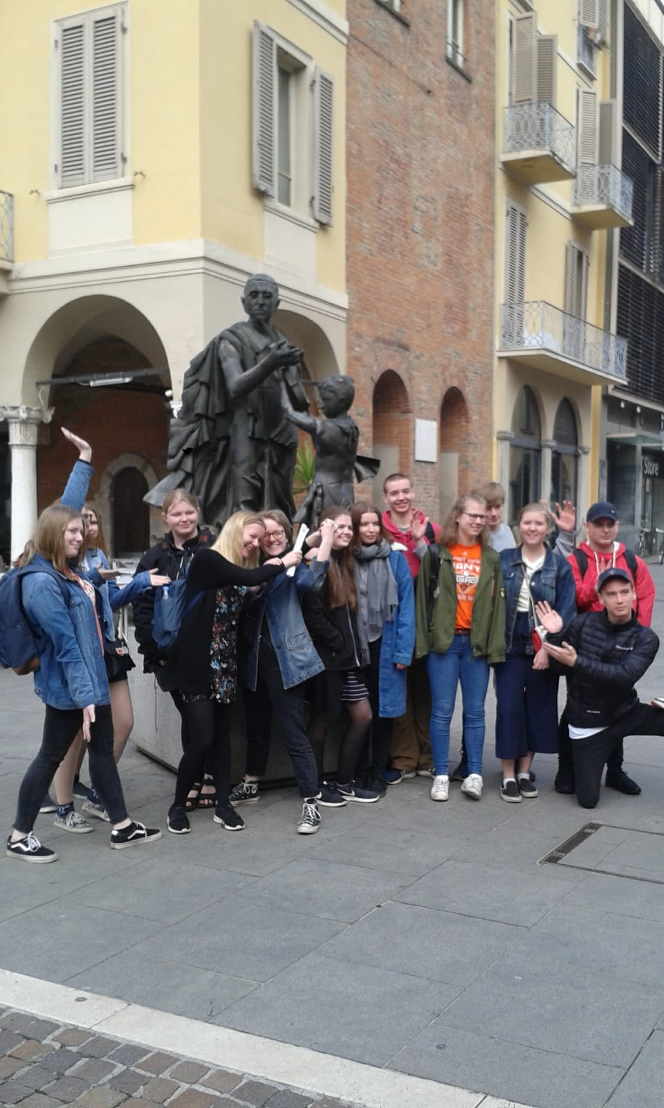
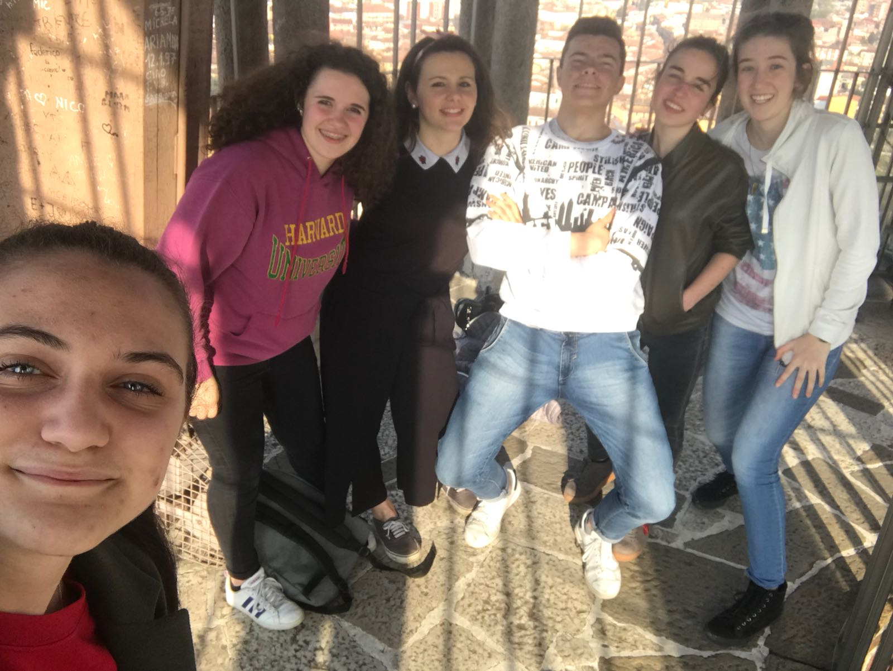
In our free time, in the afternoon, we stayed all together and we did a lot of things:
We visited the city with its monuments

Slide 3
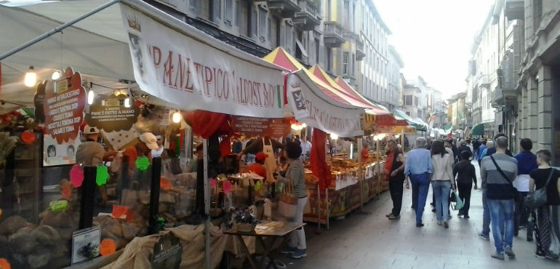
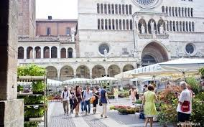
We brought our danish friends to the market in the centre of the city, where they bought some little souvenir

Slide 4
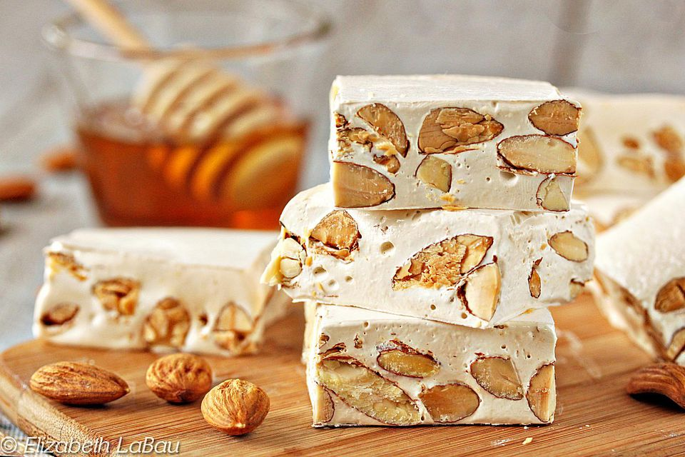
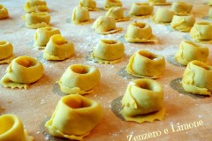
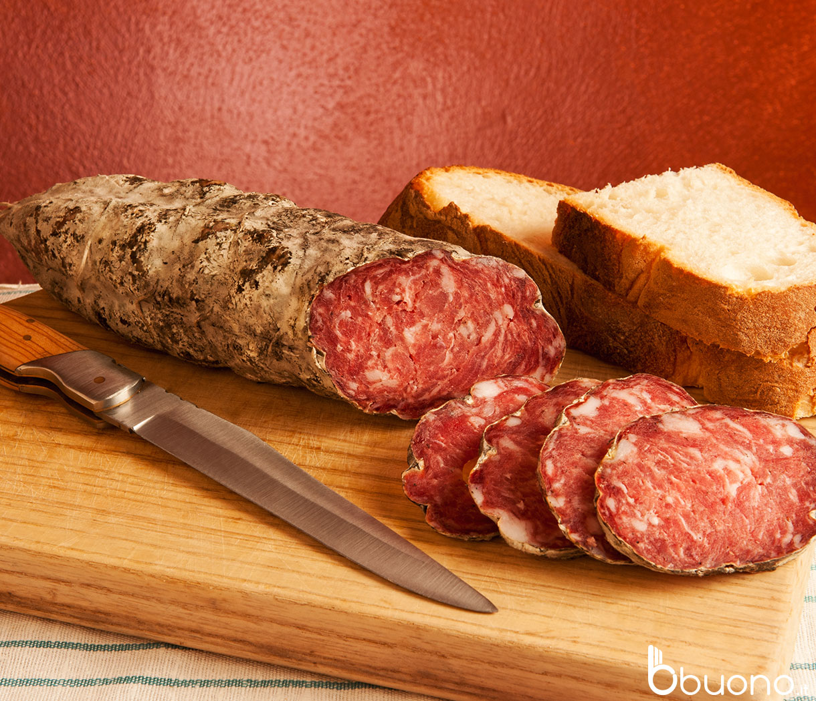
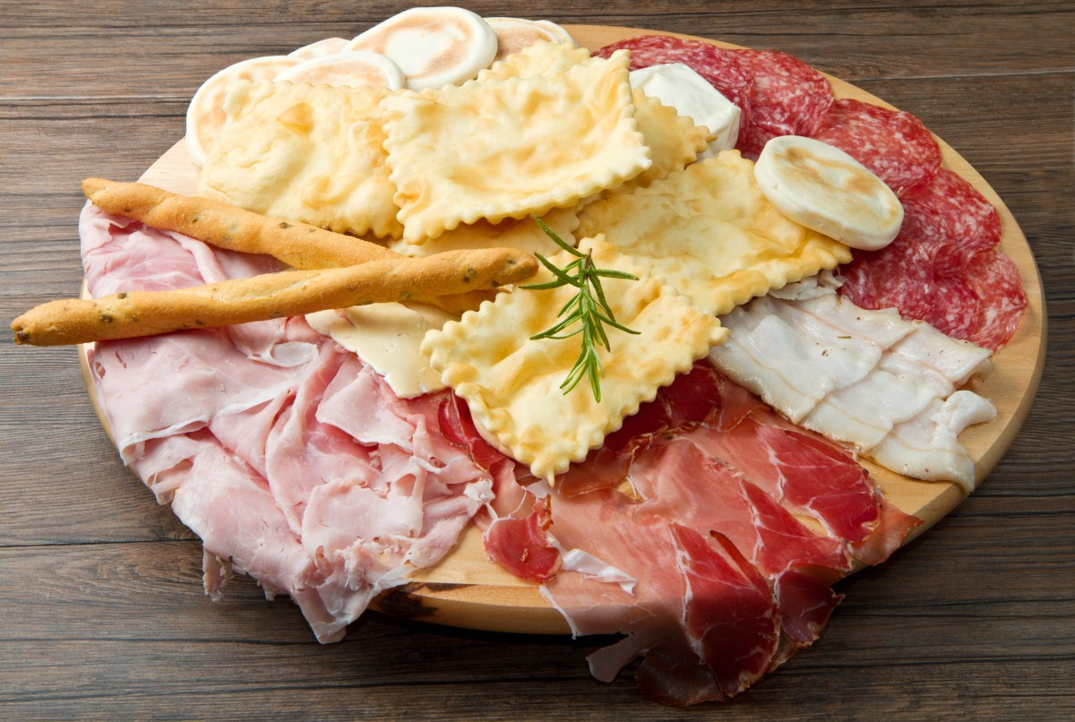
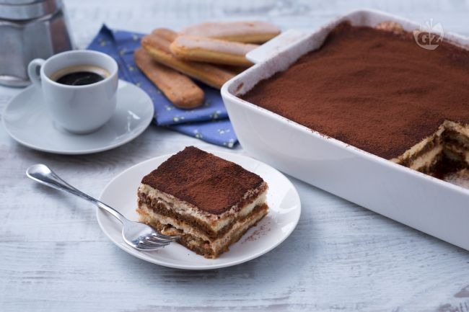
Our danish hosts could taste some typical Italian food

Slide 5
We went on a picnic and we played a famous danish game

Slide 6
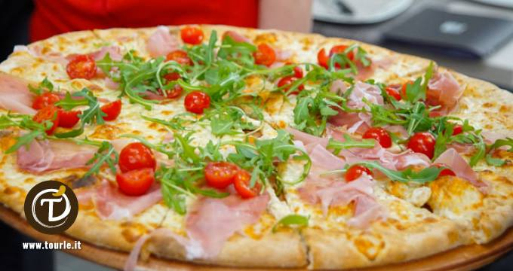
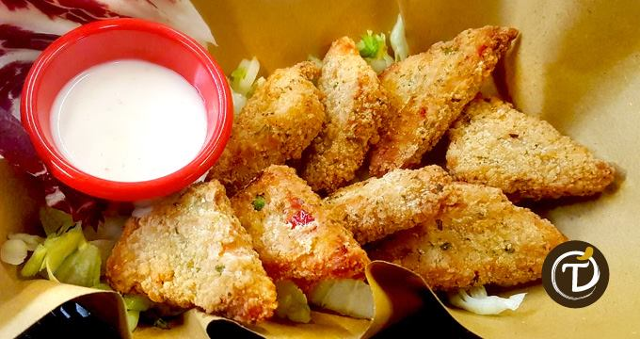
On Friday night we went to a famous Cremona restaurant for dinner because it was the last day

Slide 7
We spent a lot of time together
We knew new culture, new language and new friends
We improved our English
Realizzato da:
Bussini Elena
Chiappari Alessandro
Chiesa Francesco

